Slide 1

Security
Computer System Engineering, Fall 2019. (IPADS, SJTU)
ROP & CFI
Yubin Xia

Slide 2

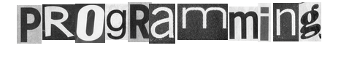

Slide 3
Review: Stack Buffer Overflow
A Typical Buffer Overflow Attack
Inject malicious code in buffer
E.g., shellcode
Overwrite return address to buffer
Once return, the malicious code runs
01010110101010111010
return addr
saved ebp
ebp
0110110101010101010101101010101010101010
void function(char *str) {
char buf[16];
strcpy(buf,str);
}
buf

Slide 4
Shellcode Sample to Open "/bin/sh" (21 bytes)
int main(){
char sc[] = "\x6a\x0b" // push byte 0xb
"\x58" // pop eax (now eax=0xb)
"\x99" // cdq
"\x52" // push edx (now edx=0)
"\x68\x2f\x2f\x73\x68" // push dword 0x68732f2f
"\x68\x2f\x62\x69\x6e" // push dword 0x6e69622f
"\x89\xe3" // mov ebx, esp
"\x31\xc9" // xor ecx, ecx (now ecx=0)
"\xcd\x80"; // int 0x80
((void (*)()) sc)();
}
More can be found on https://www.exploit-db.com
Notes:
Convert Double to Quad的缩写，意为将双字数据扩展为四字。 该指令先把edx的每一位置成eax的最高位（若eax>=0x80000000, 则edx=0xFFFFFFFF；若eax<0x80000000，则edx=0x00000000） ，再把edx扩展为eax的高位。
68: h
73: s
2f: /
2f: /
6e: n
69: i
62: b
2f: /

Slide 5
Defense: DEP (Data Execution Prevention)
Execute Code, not Data
Data areas marked non-executable
Stack marked non-executable
Heap marked non-executable
Hardware enforced (NX: Non-eXecutable)
You can load your shellcode in the stack or the heap…but you can't jump to it

Slide 6
Attack: Code Reuse (instead of inject) Attack
ROP: Return-oriented Programming
Find code gadgets in existed code base
Usually 1-3 instructions, ends with 'ret'
In libc and application, intended and unintended
Push address of gadgets on the stack
Leverage 'ret' at the end of gadget to connect each code gadgets
No code injection
0101011010
0101011010
0101011010
return addr
0101011010
saved ebp
0101011010
0101011010
0101011010

Slide 7
Code Execution – The ROP Way
Mem[v2] = v1
a₃
v₂
a₂
v₁
Desired Logic
Stack
mov %eax v1;
mov %ebx v2;
mov [%ebx], %eax
a₁: pop eax; ret
a₂: pop ebx; ret
a₃: mov [ebx], eax

Slide 8
Code Execution – ROP Way
a₃
v₂
a₂
v₁
a₁
…
argv
argc
return addr
caller's ebp
buf (64 bytes)
argv[1]
buf
Mem[v2] = v1
Desired Shellcode
%ebp
a₁: pop eax; ret
a₂: pop ebx; ret
a₃: mov [ebx], eax
Desired store executed!
%esp

Slide 9
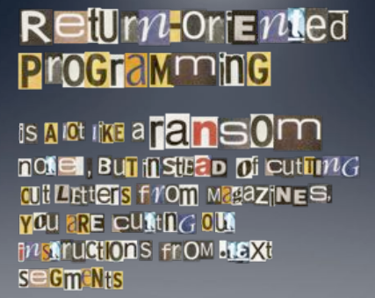

Slide 10
Defense
Hide the binary file
No way to get any gadget
ASLR to randomize the code position
Short for "Address Space Layout Randomization"
Harder to find gadgets
Canary to protect the stack
Try to detect stack overflow (e.g., overflow return address)

Slide 11
ASLR
Change the layout of memory space
Every time when a process is created
Question: how about create by fork?
User-level as well as kernel-level

Slide 12

Canary
Stack
Embed "canaries" in stack frames and verify their integrity prior to function return
Canary is just a random number
Check canary before return, alert if not equal
StackGuard implemented as a GCC patch
Program must be recompiled
Performance overhead: 8% for Apache
Return Addr
Canary

Slide 13
CFI: Control Flow Integrity

Slide 14
CFI: Control-Flow Integrity
Main idea: pre-determine control flow graph (CFG) of an application
Static analysis of source code
Static binary analysis ← CFI
Execution profiling
Explicit specification of security policy
Execution must follow the pre-determined control flow graph

Slide 15
CFI Motivation
Control flow
Anatomy of many software attacks
Notes:
Many software attacks consists in subverting the control-flow of a binary. Often the virus injects code of its own,. Then by a buffer overflow, it hijacks the program counter to execute the desired code, eventually reaching a point at which the system is compromised (e.g., a shell is executed).

Slide 16
CFI Idea
+
=
Executable
Control-Flow Graph
Self-checking program
Notes:
The idea of CFI is very simple: embed a simple security policy within the executable itself, in the form of a control-flow graph. The executable itself will monitor its execution, and any attempt to deviate from the prescribed CFG will result in an error. Thus, if a virus attempts to step outside the prescribed CFG, it will shut down the program.

Slide 17
Branch Types
Direct Branches
Direct call
Direct jump
Indirect Branches
Return
Indirect call
Indirect jump
In Apache and its libraries
Types | In Binary | Run-time
Direct call | 16.8% | 14.5%
Direct jump | 74.3% | 0.8%
Return | 6.3% | 16.3%
Indirect call | 2.1% | 0.2%
Indirect jump | 0.5% | 68.3%
has 1 target: 94.7%
<= 2 targets: 99.3%
>10 targets: 0.1%

Slide 18
CFI: Binary Instrumentation
Use binary rewriting to instrument code with runtime checks
Inserted checks ensure that the execution always stays within the statically determined CFG
Whenever an instruction transfers control, destination must be valid according to the CFG
Goal: Secure even if the attacker has complete control over the thread's address space

Slide 19
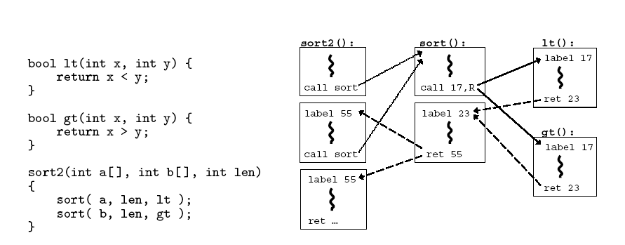
CFG Example

Slide 20
CFI: Control Flow Enforcement
For each control transfer, determine statically its possible destination(s)
Insert a unique bit pattern at every destination
Two destinations are equivalent if CFG contains edges to each from the same source
This is imprecise (why?)
Use same bit pattern for equivalent destinations

Slide 21
CFI: Control Flow Enforcement
Insert binary code that at runtime will check whether the bit pattern of the target instruction matches the pattern of possible destinations

Slide 22
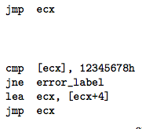
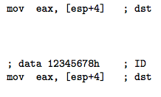
CFI: Example of Instrumentation
Original
Patched

Slide 23
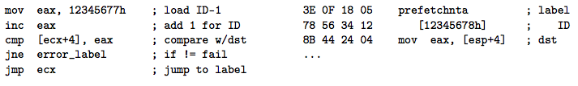
CFI: Example of Instrumentation
Prefetchnta: prefetch memory to cache. Become a nop if not available.

Slide 24
CFI: Preventing Circumvention
Unique IDs
Bit patterns chosen as destination IDs must not appear anywhere else in the code memory except ID checks
Non-writable code
Program should not modify code memory at runtime
What about run-time code generation and self-modification?
Non-executable data
Program should not execute data as if it were code
Enforcement: hardware support + prohibit system calls that change protection state + verification at load-time

Slide 25
Improving CFI Precision
Suppose a call from A goes to C, and a call from B goes to either C, or D (when can this happen?)
CFI will use the same tag for C and D, but this allows an "invalid" call from A to D
Possible solution: duplicate code or inline
Possible solution: multiple tags

Slide 26
Improving CFI Precision
Function F is called first from A, then from B; what's a valid destination for its return?
CFI will use the same tag for both call sites, but this allows F to return to B after being called from A
Solution: shadow call stack
Maintain another stack, just for return address
Intel CET to the rescue (not available yet)

Slide 27
CFI: Security Guarantees
Effective against attacks based on illegitimate control-flow transfer
Stack-based buffer overflow, return-to-libc exploits, pointer subterfuge
Does not protect against attacks that do not violate the program's original CFG
Incorrect arguments to system calls
Substitution of file names
Other data-only attacks

Slide 28
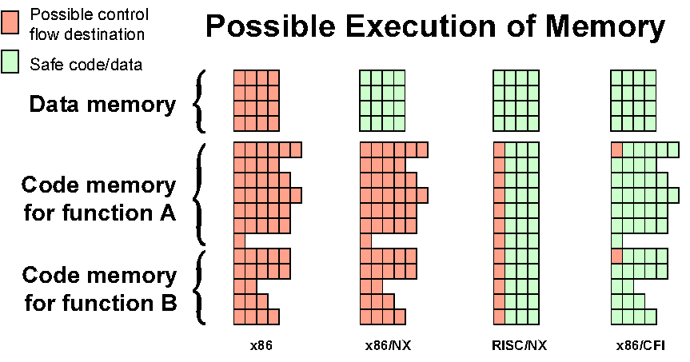
Possible Execution of Memory
[Erlingsson]

Slide 29
Blind ROP

Slide 30
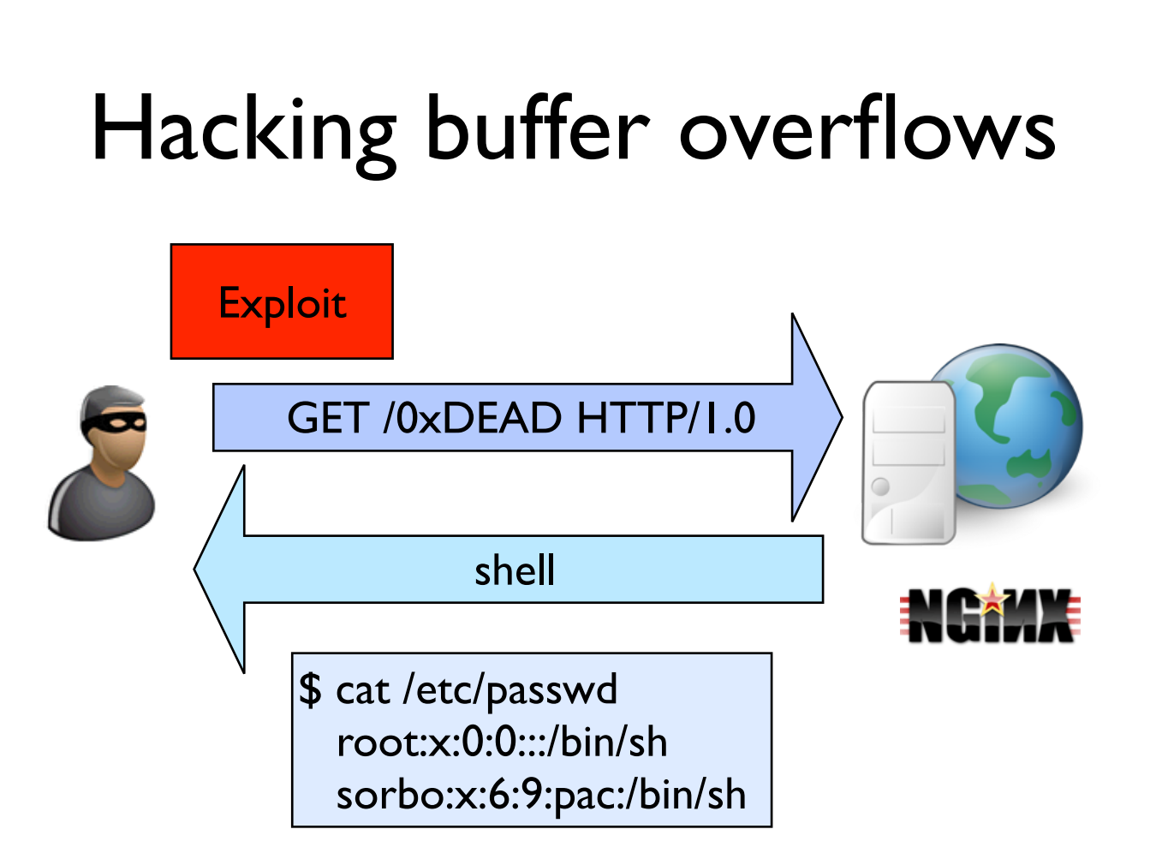

Slide 31
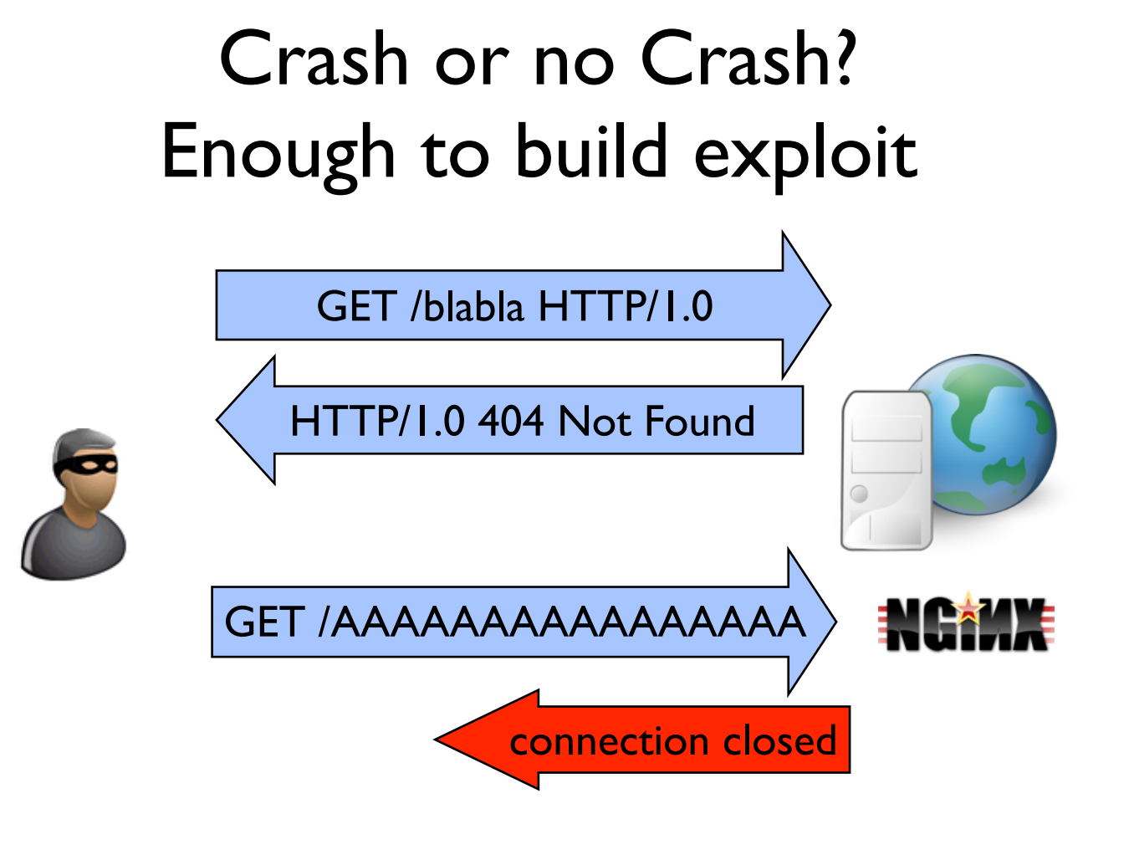

Slide 32
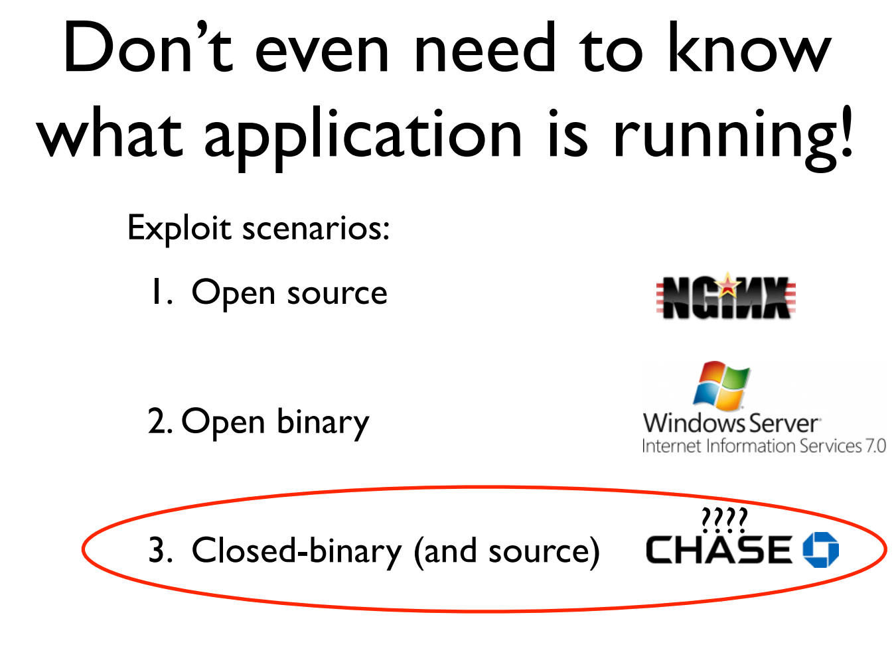

Slide 33
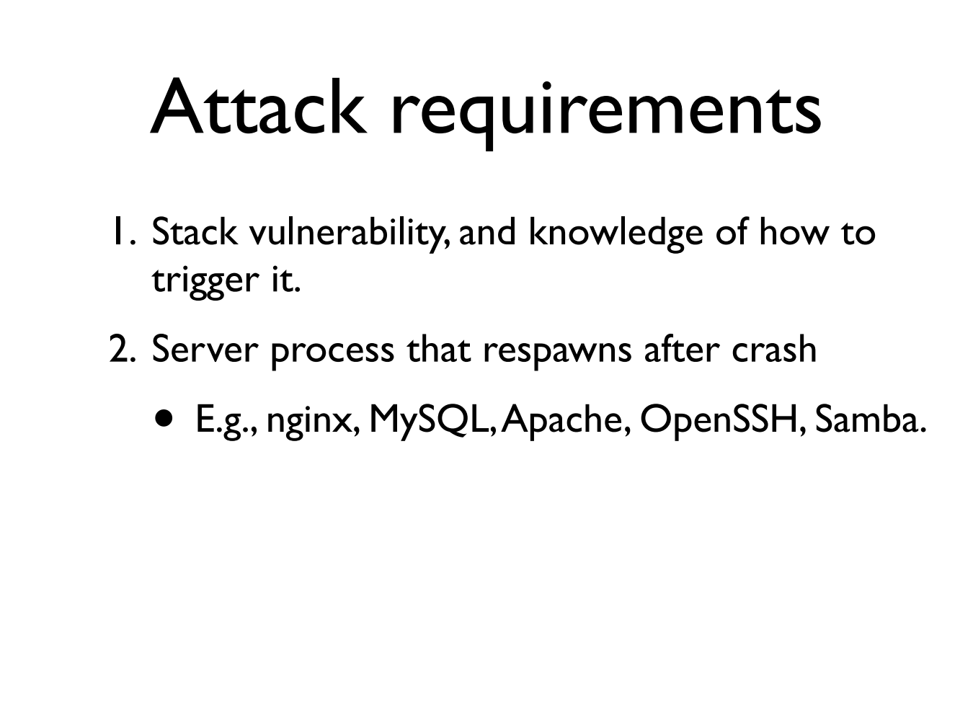

Slide 34
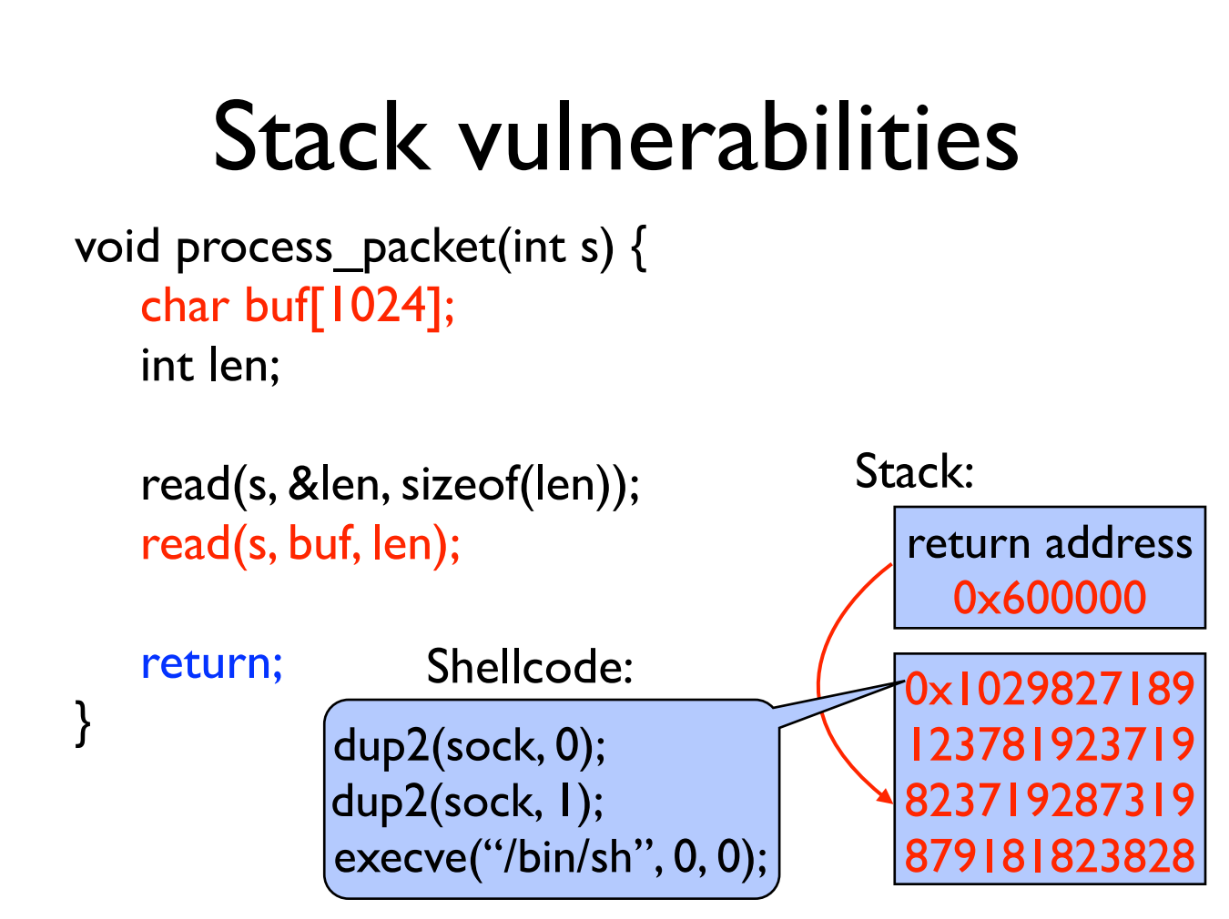

Slide 35
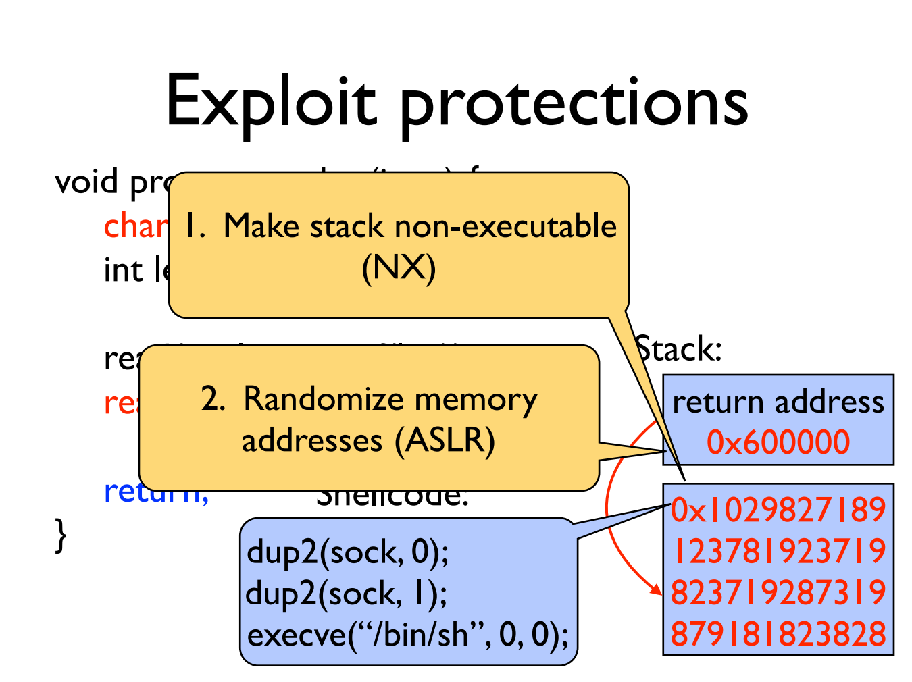

Slide 36
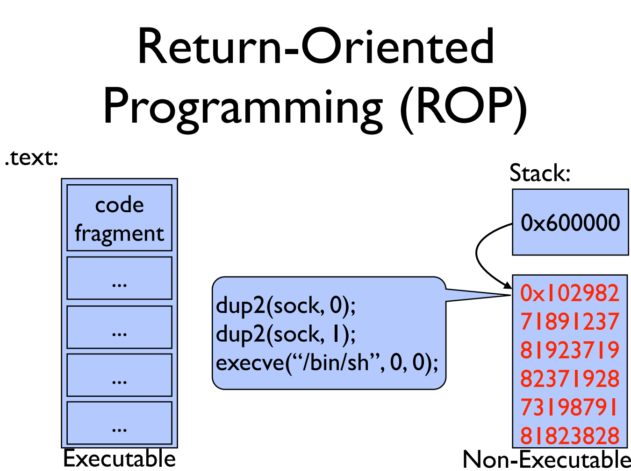

Slide 37
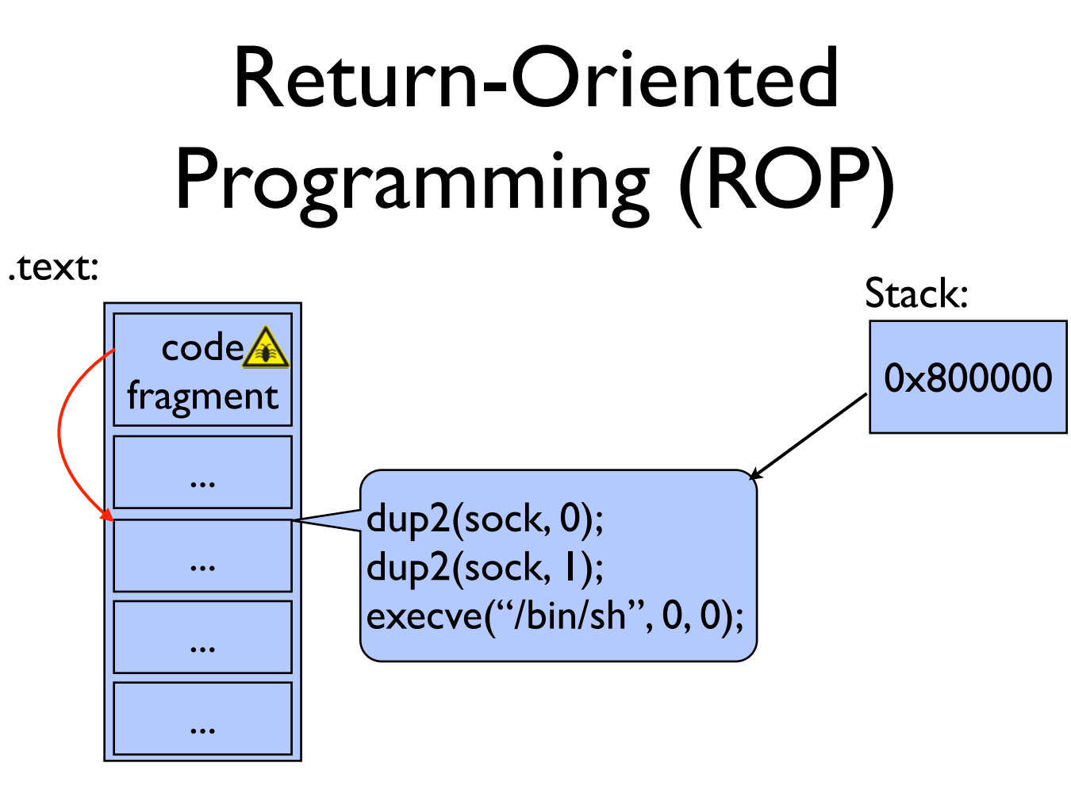

Slide 38
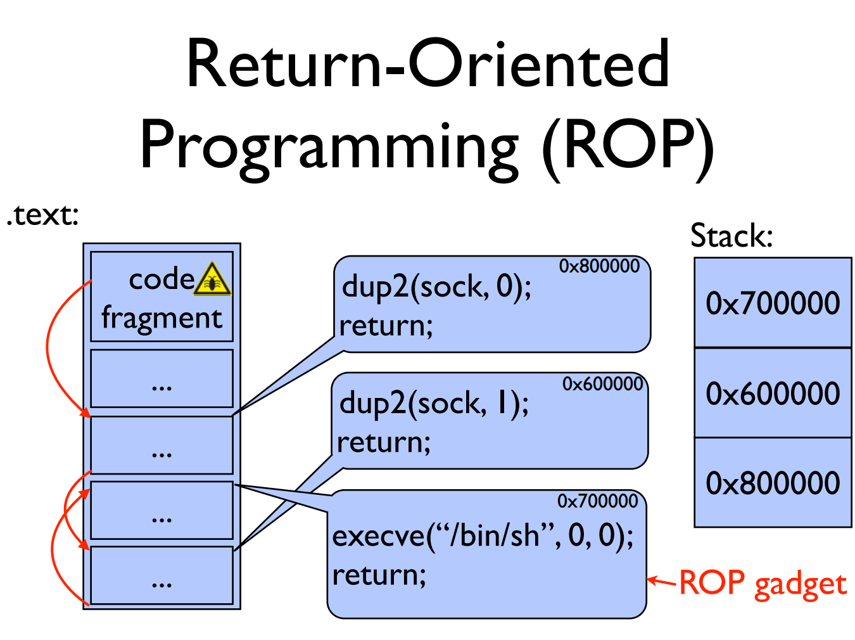

Slide 39
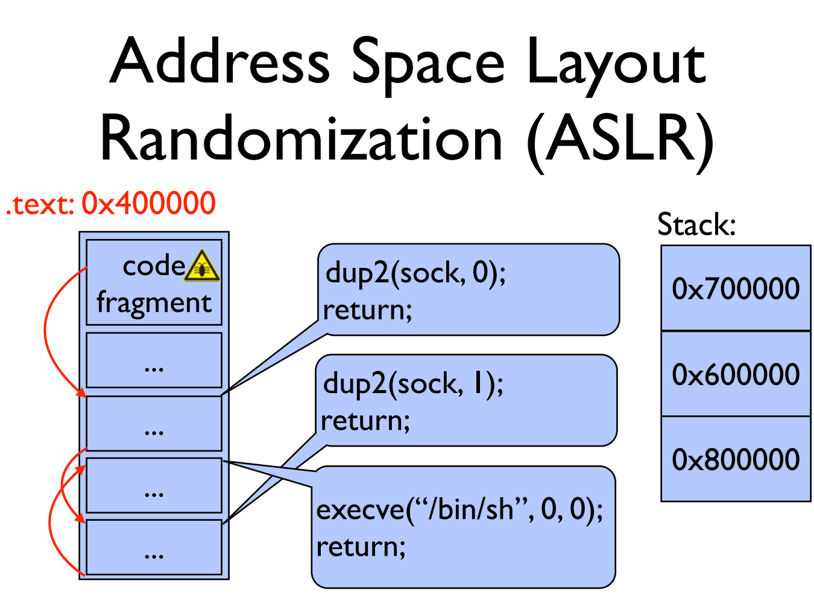

Slide 40
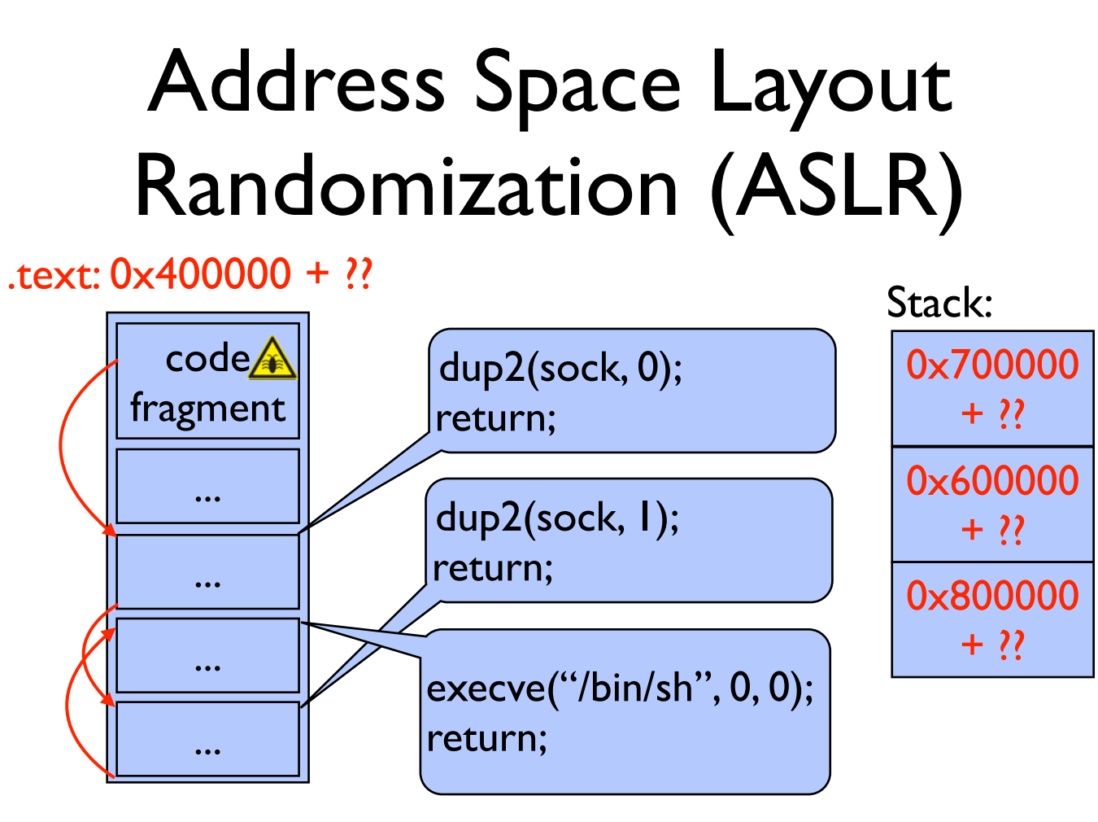

Slide 41
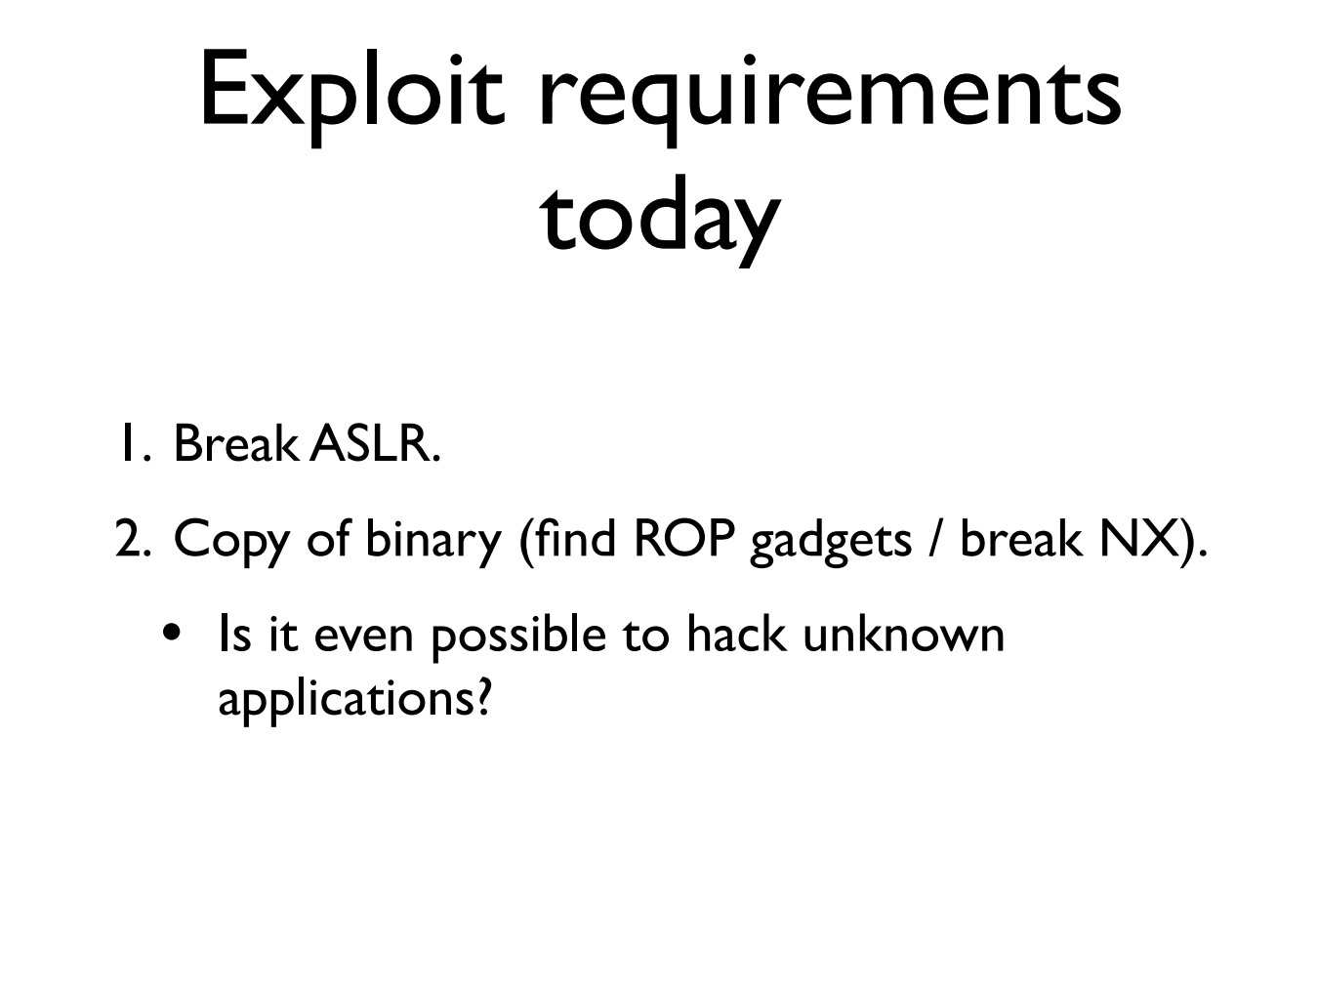

Slide 42
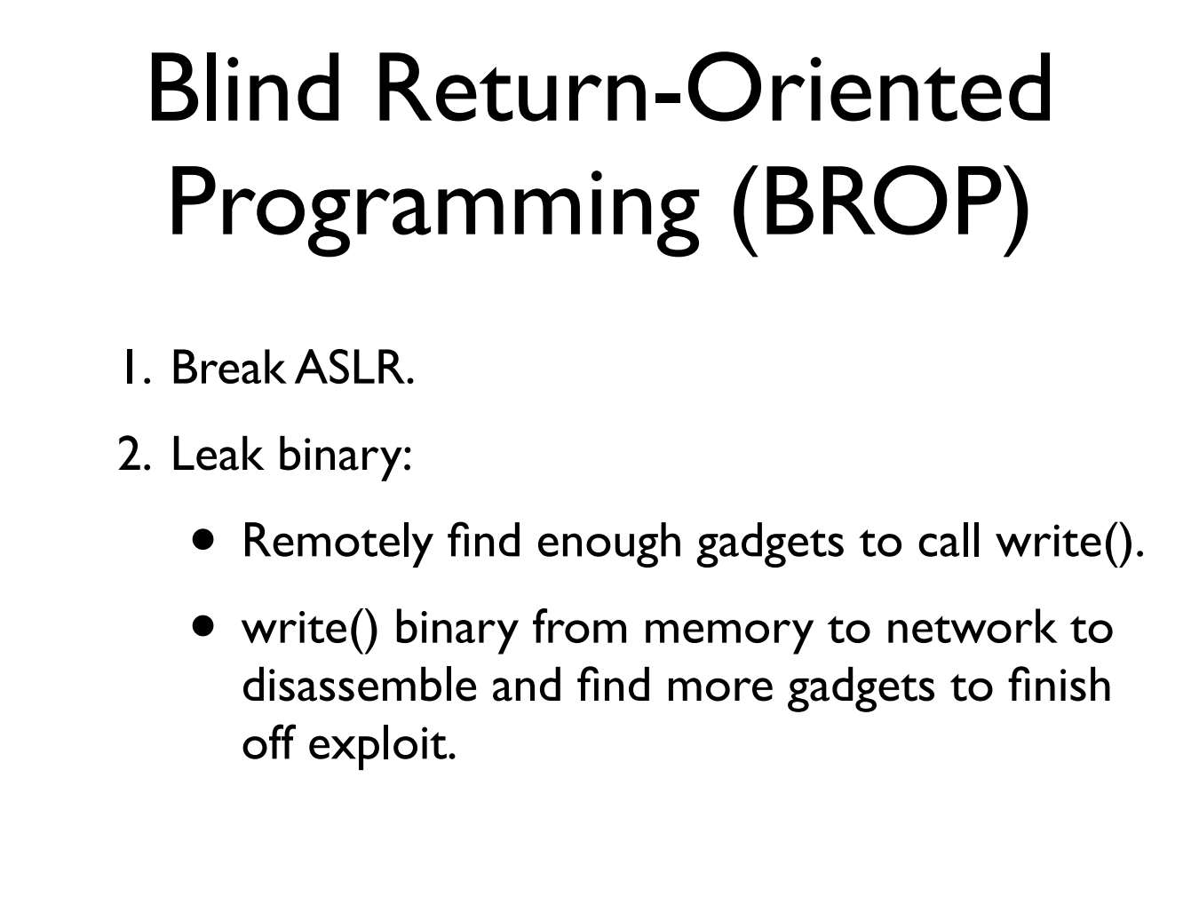

Slide 43
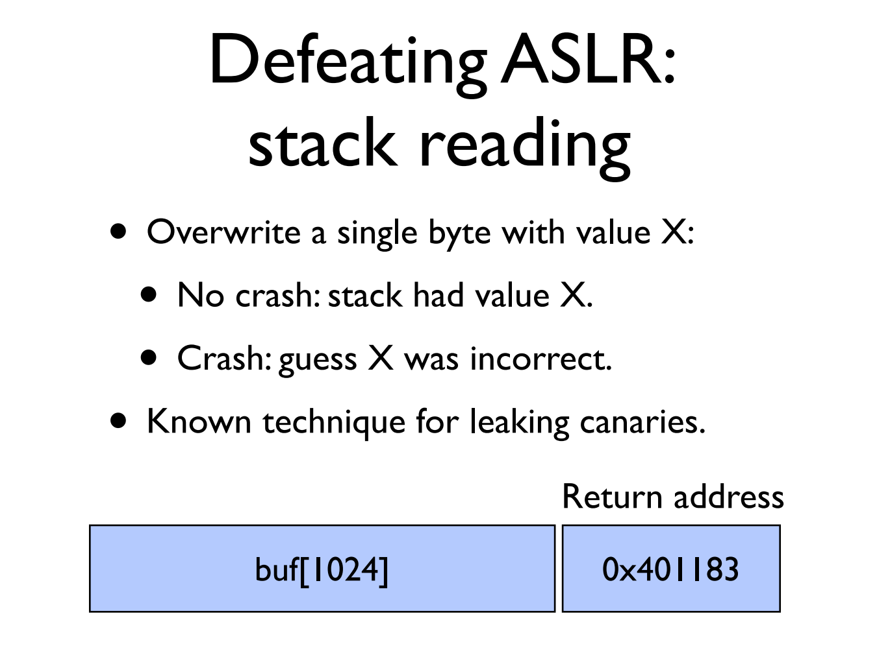

Slide 44
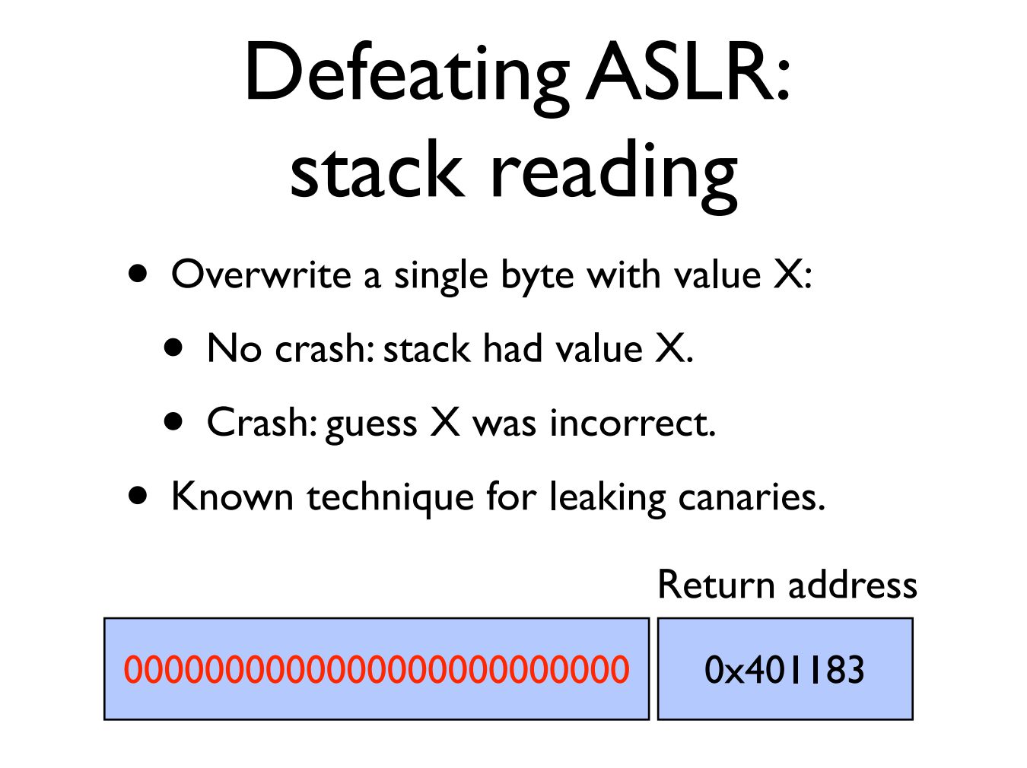

Slide 45
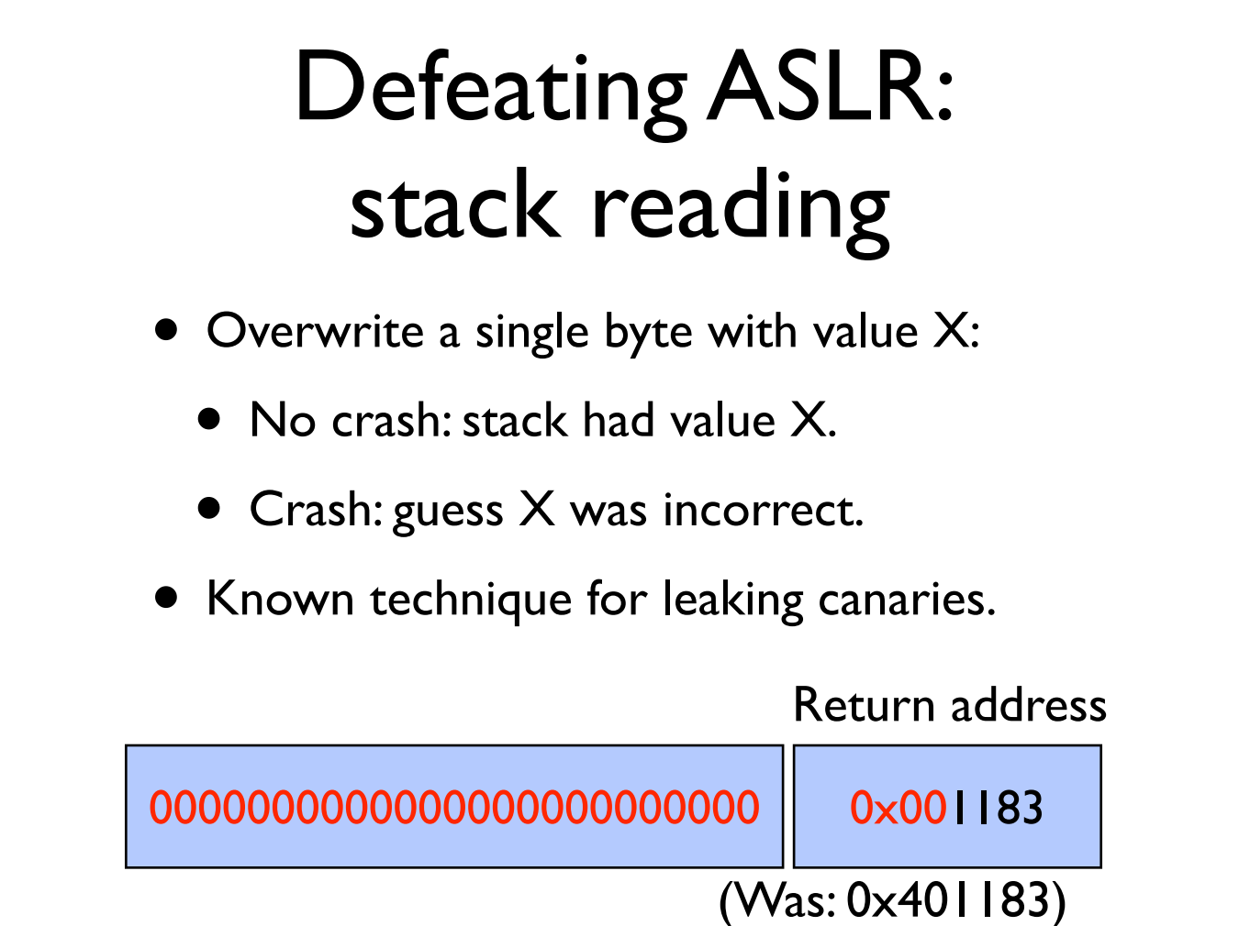

Slide 46


Slide 47


Slide 48
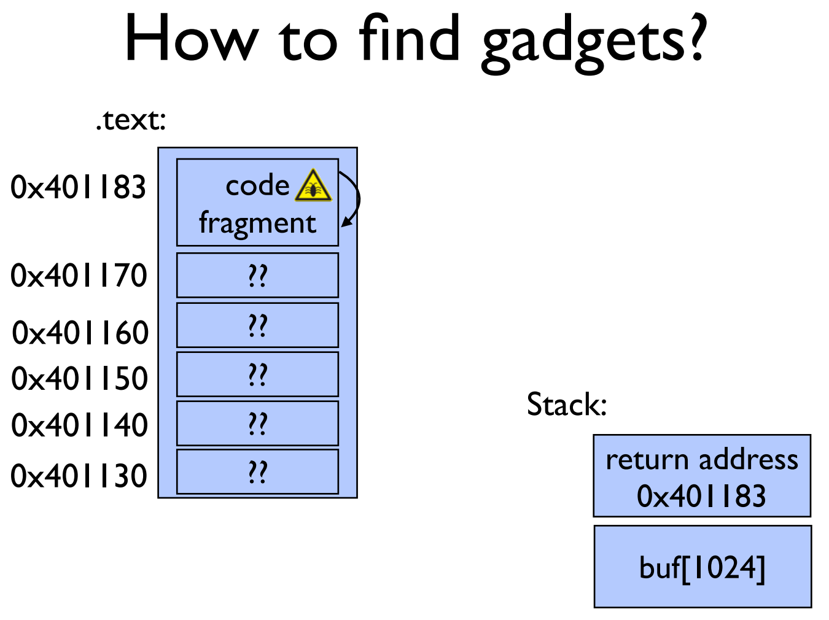

Slide 49
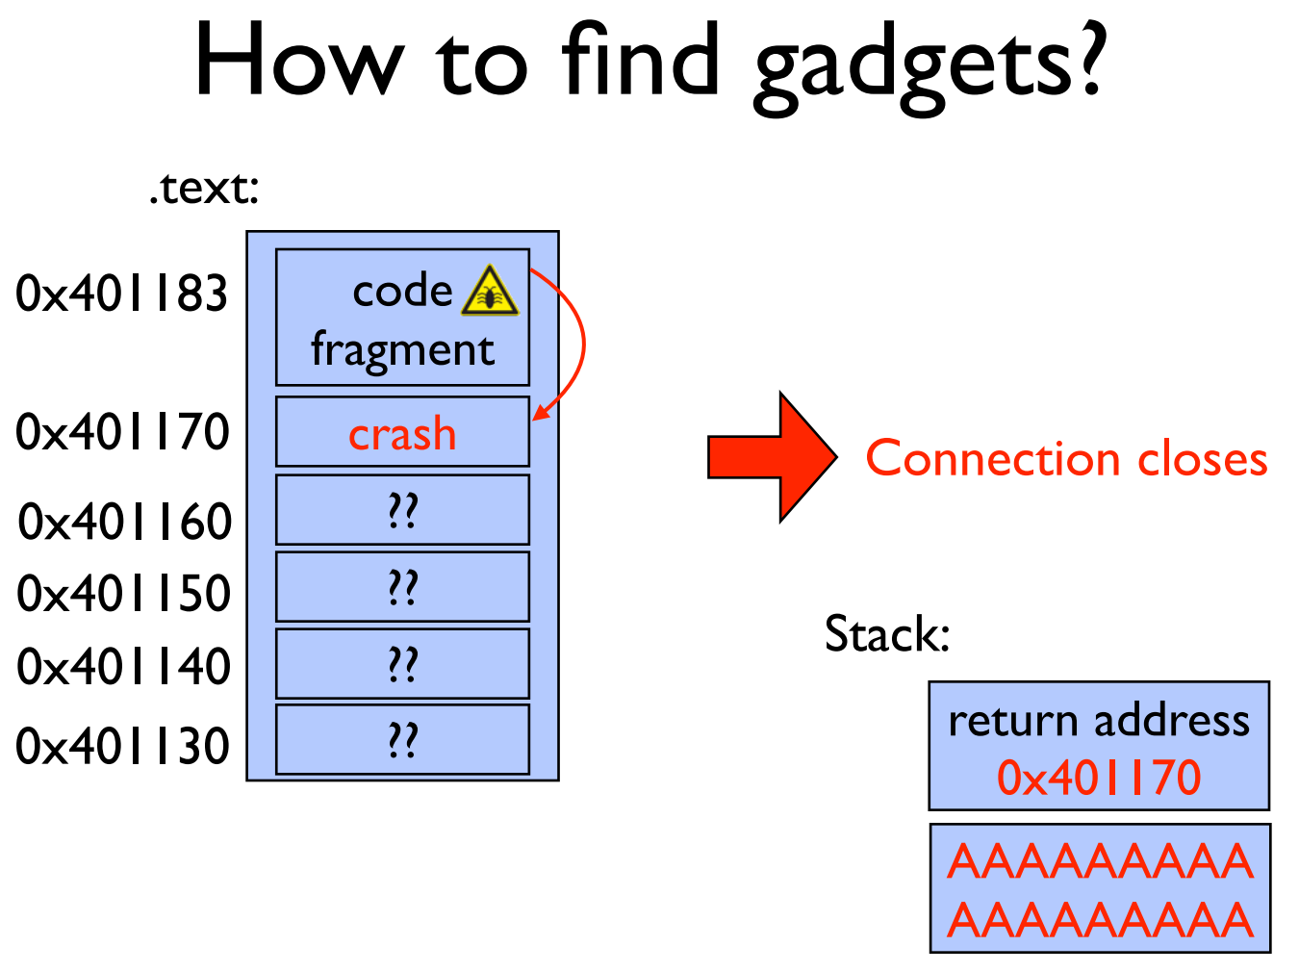

Slide 50


Slide 51
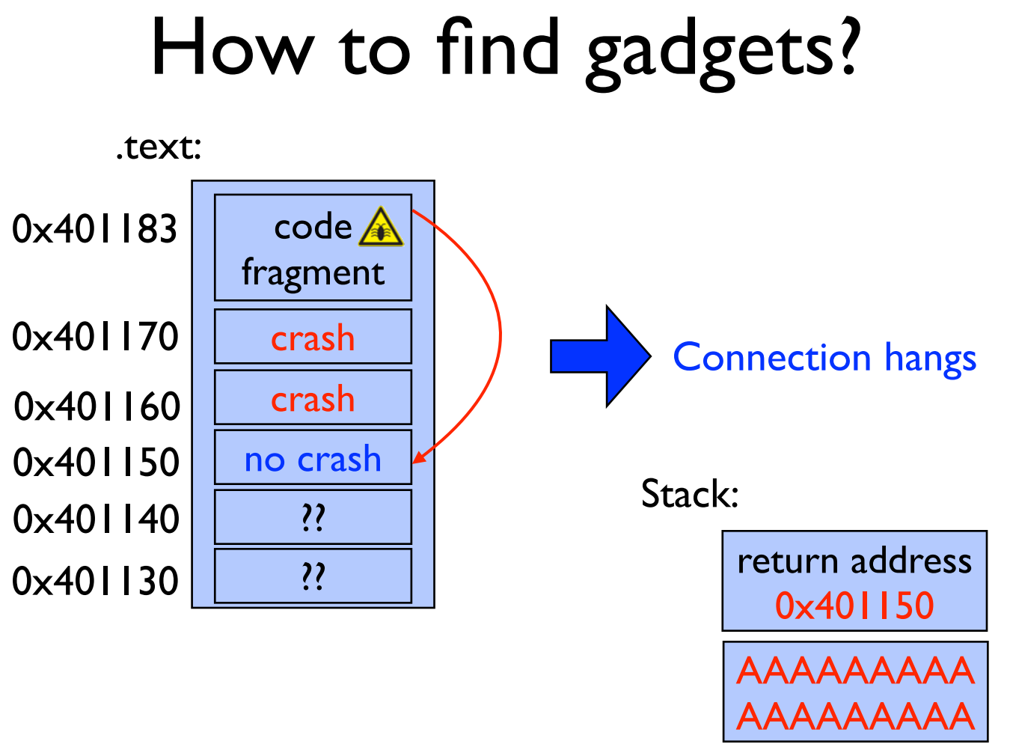

Slide 52
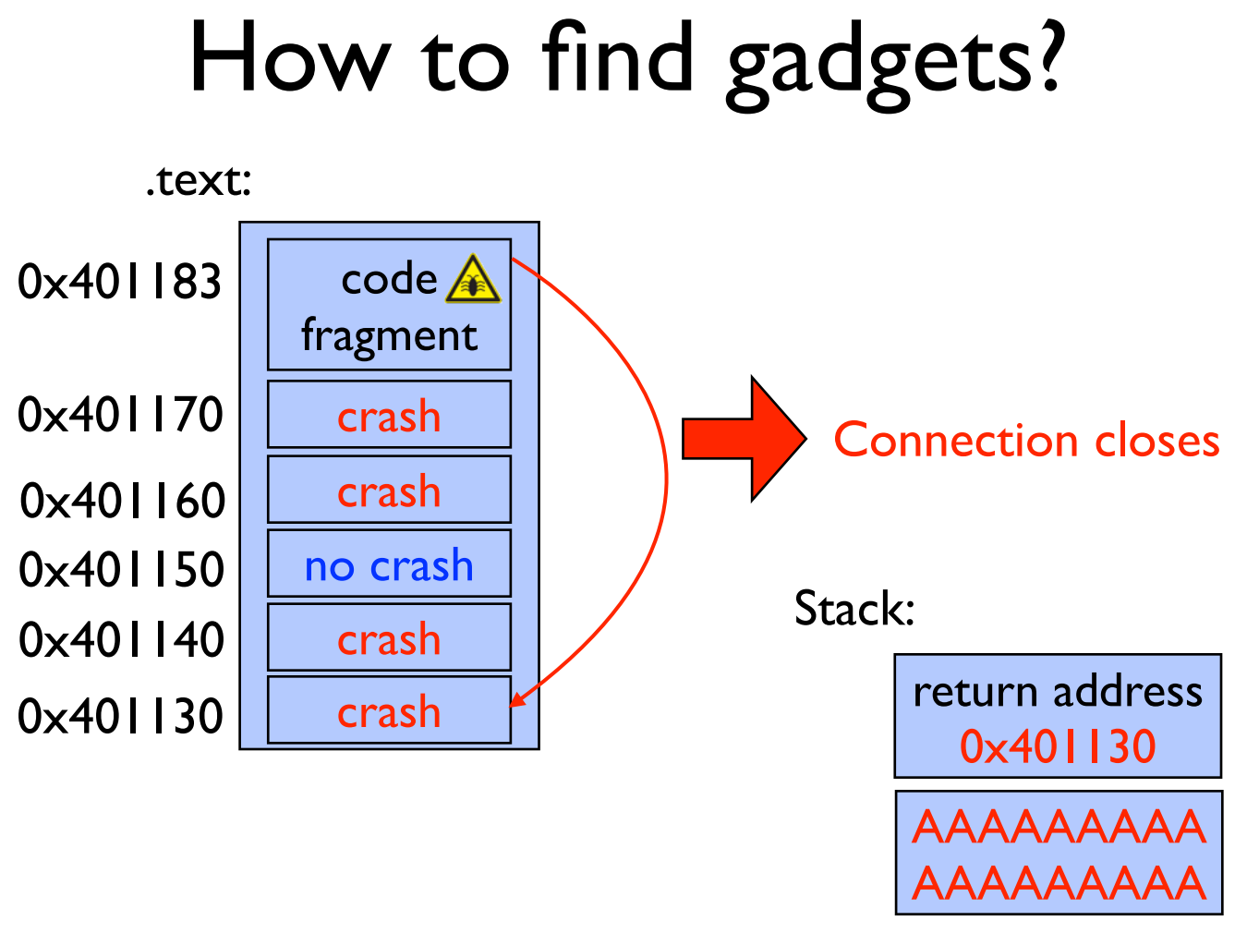

Slide 53
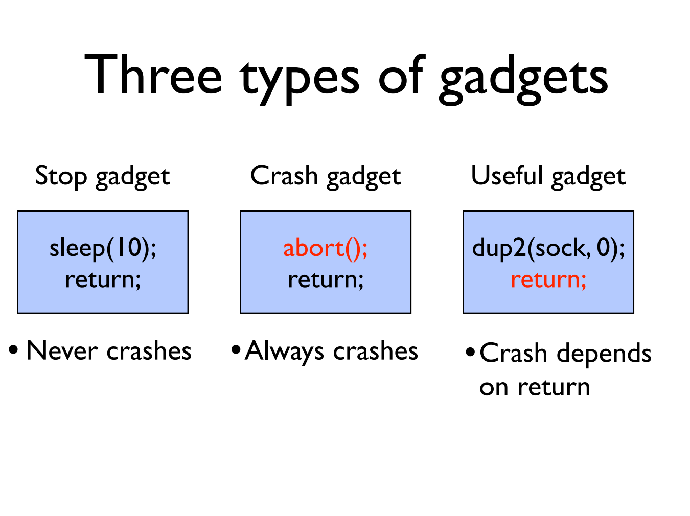

Slide 54
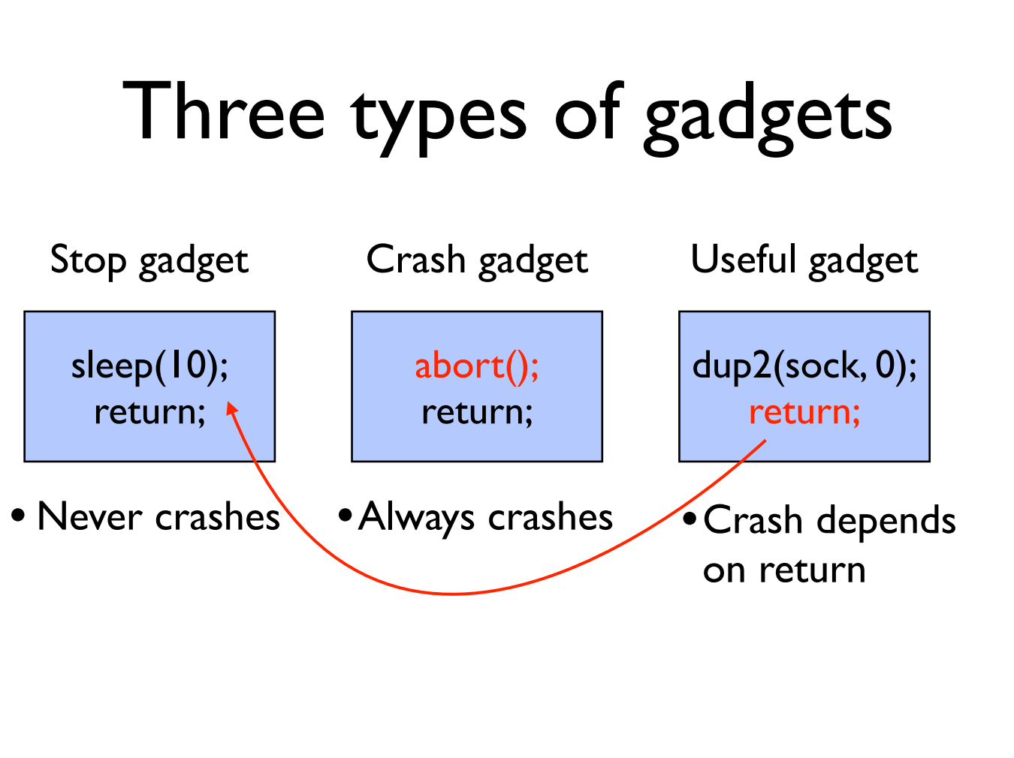

Slide 55
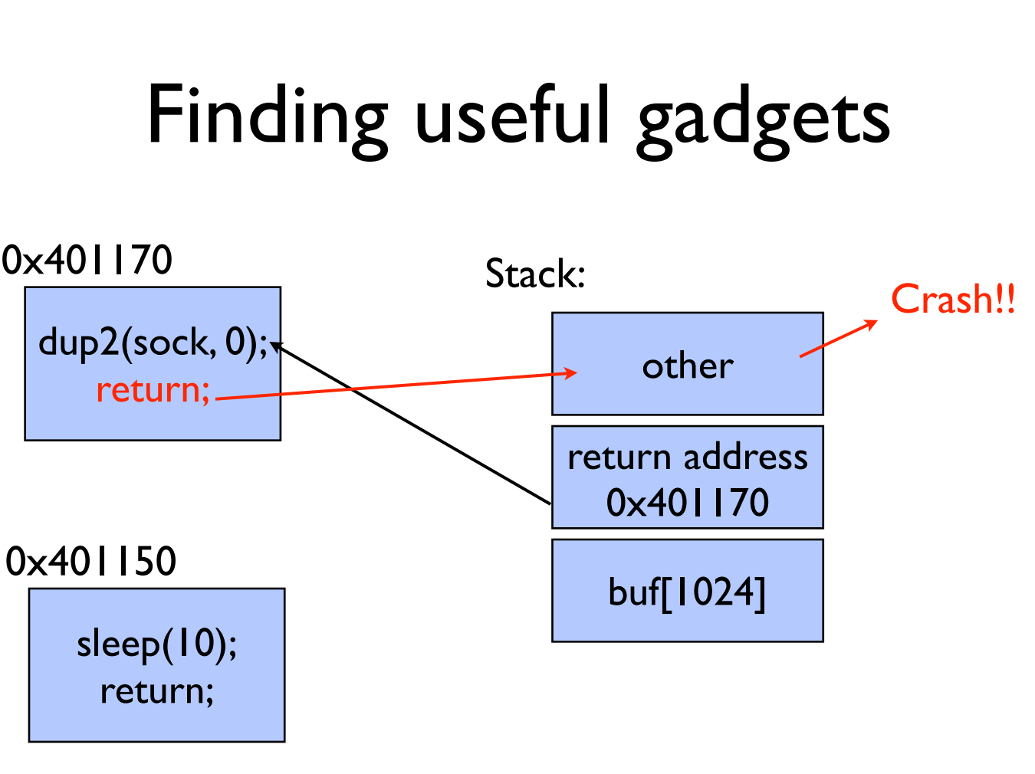

Slide 56
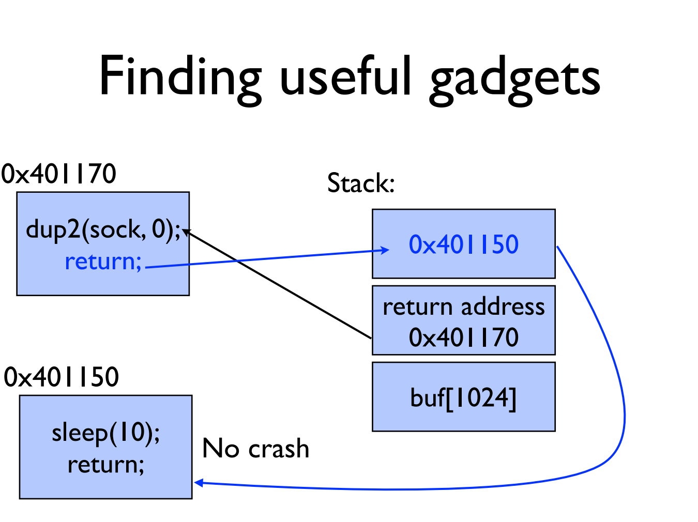

Slide 57
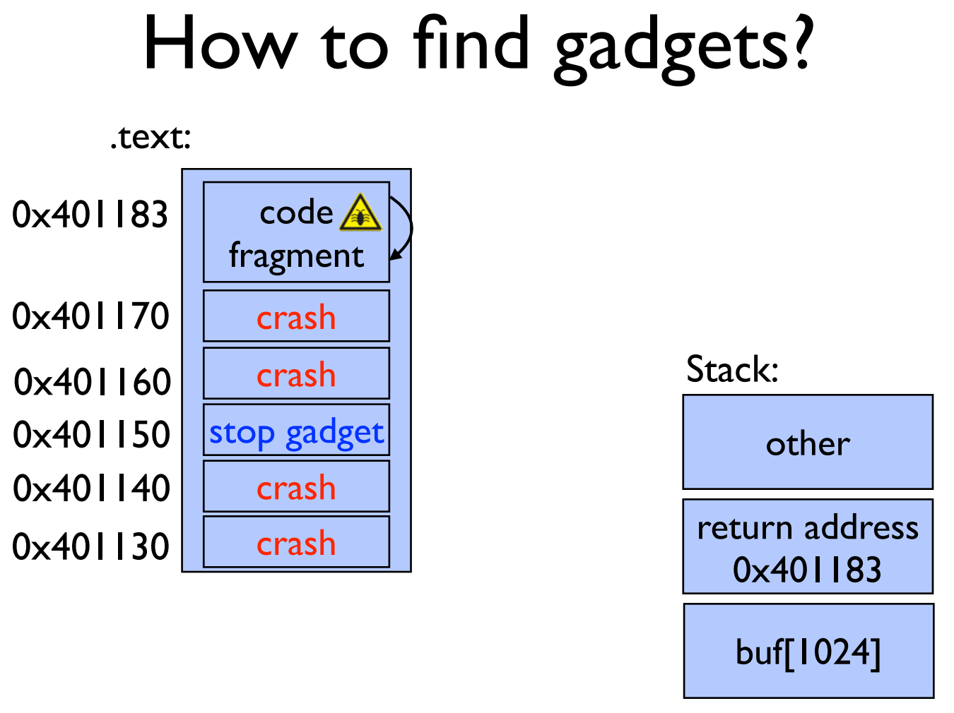

Slide 58
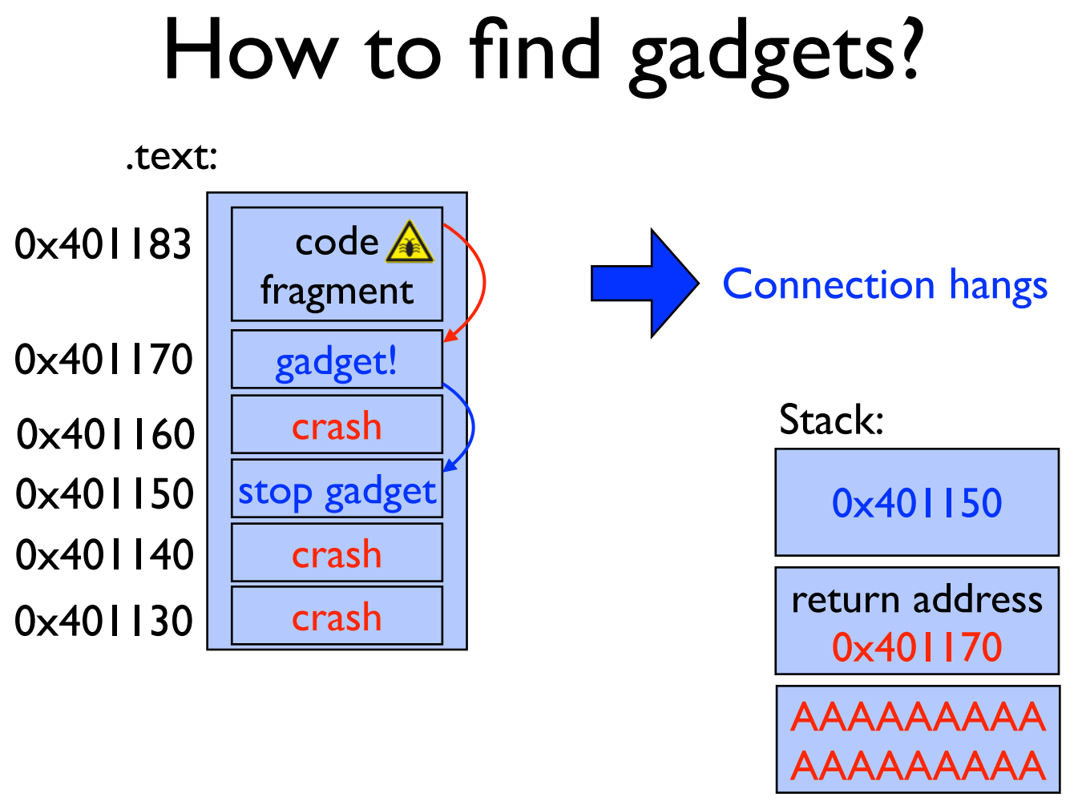

Slide 59
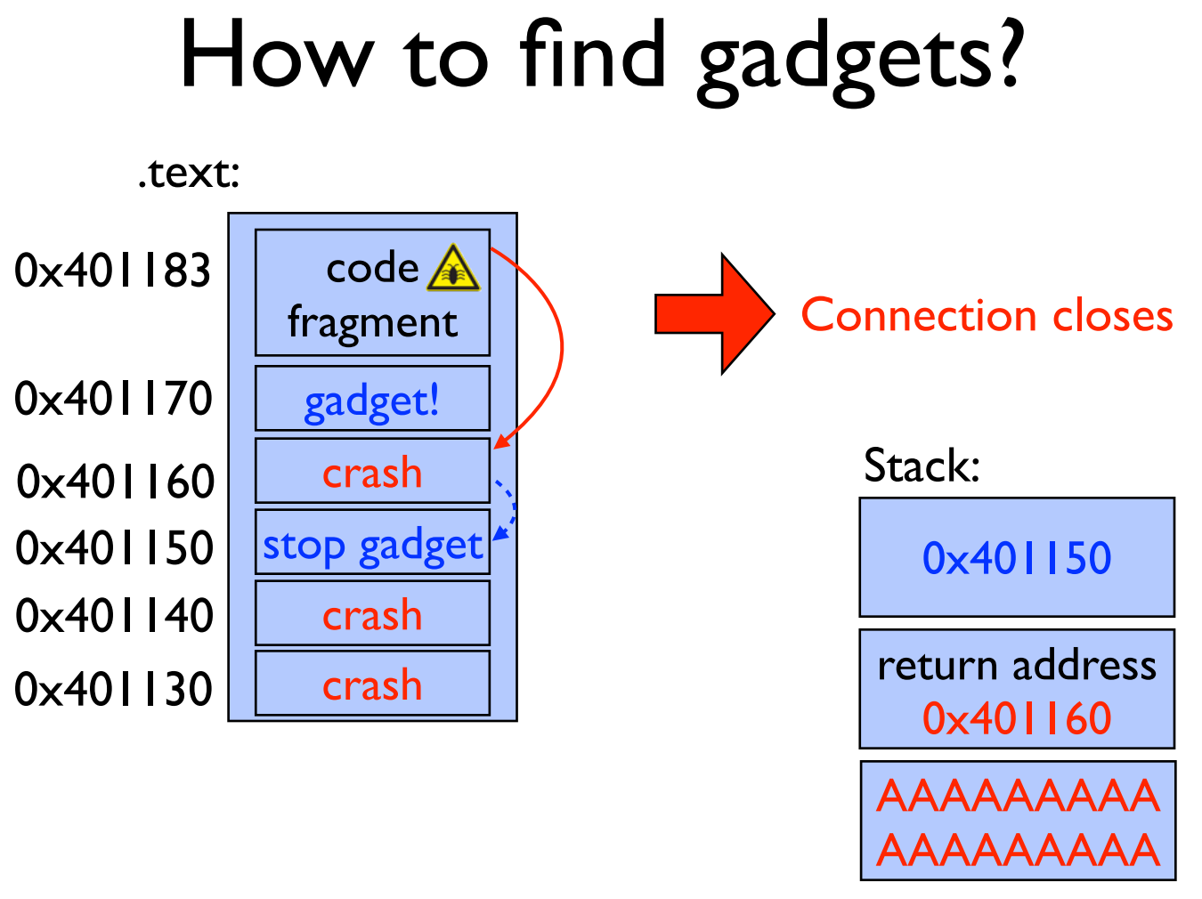

Slide 60
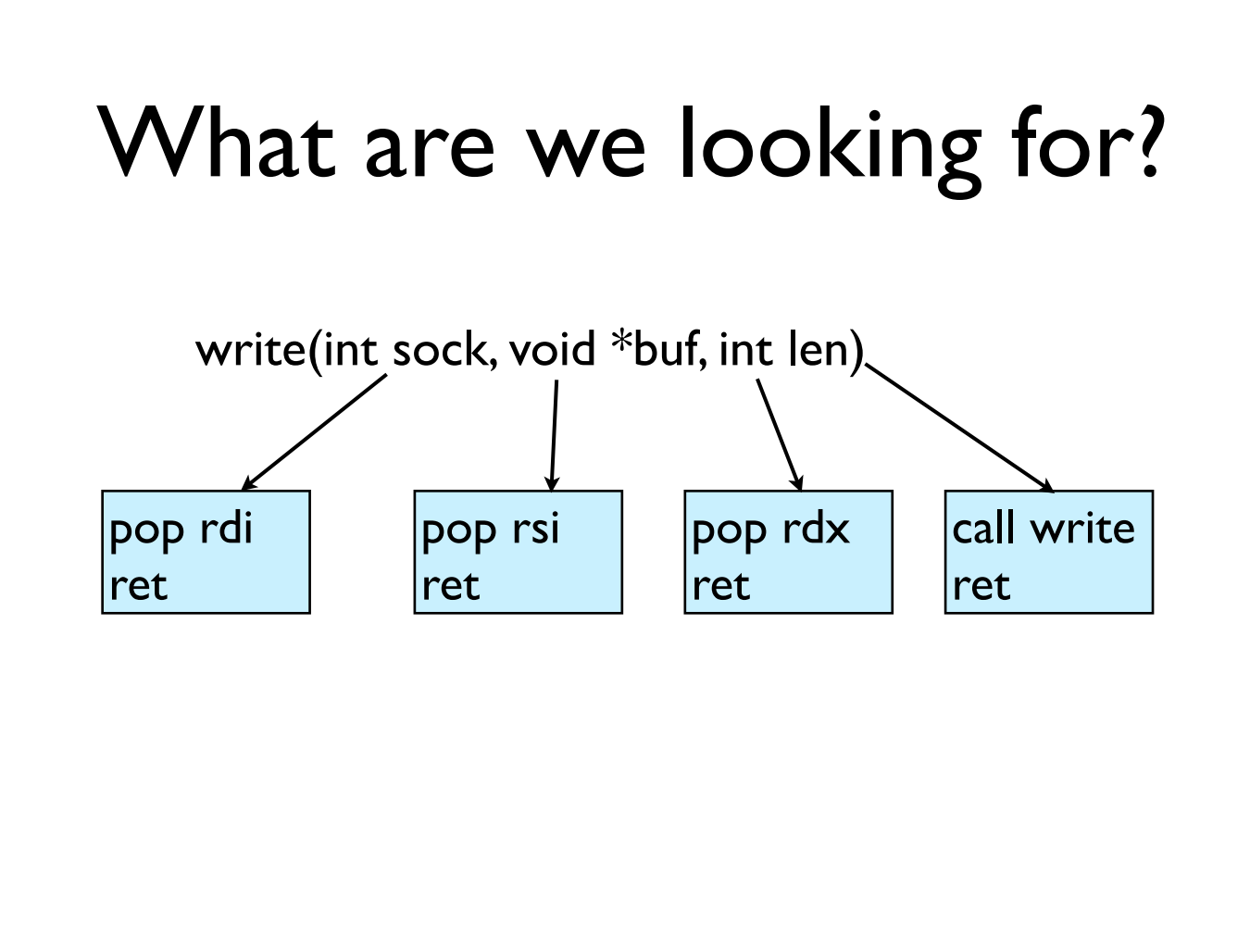

Slide 61
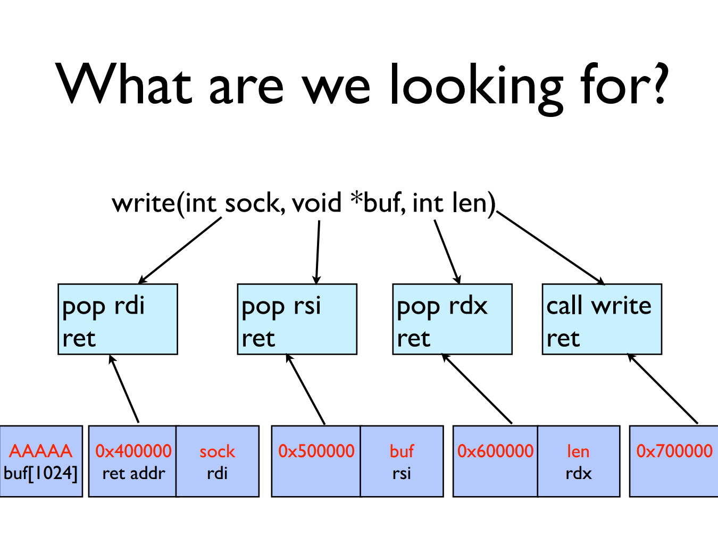

Slide 62
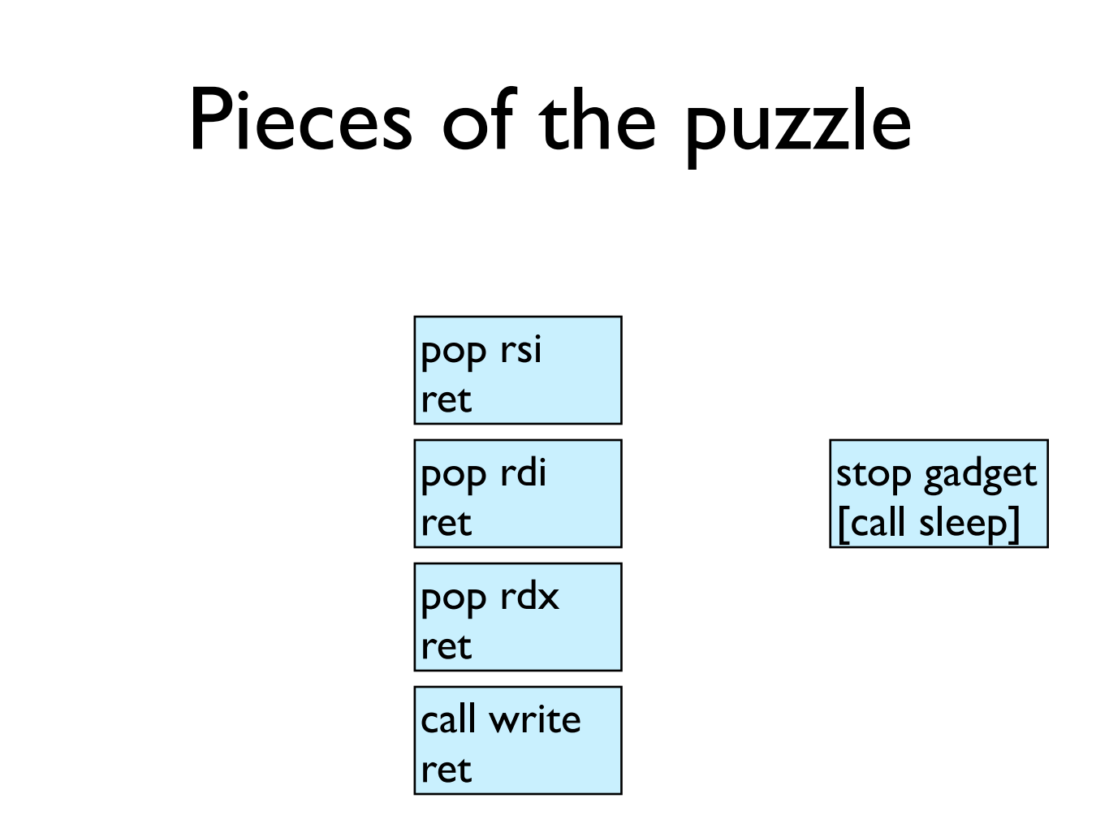

Slide 63
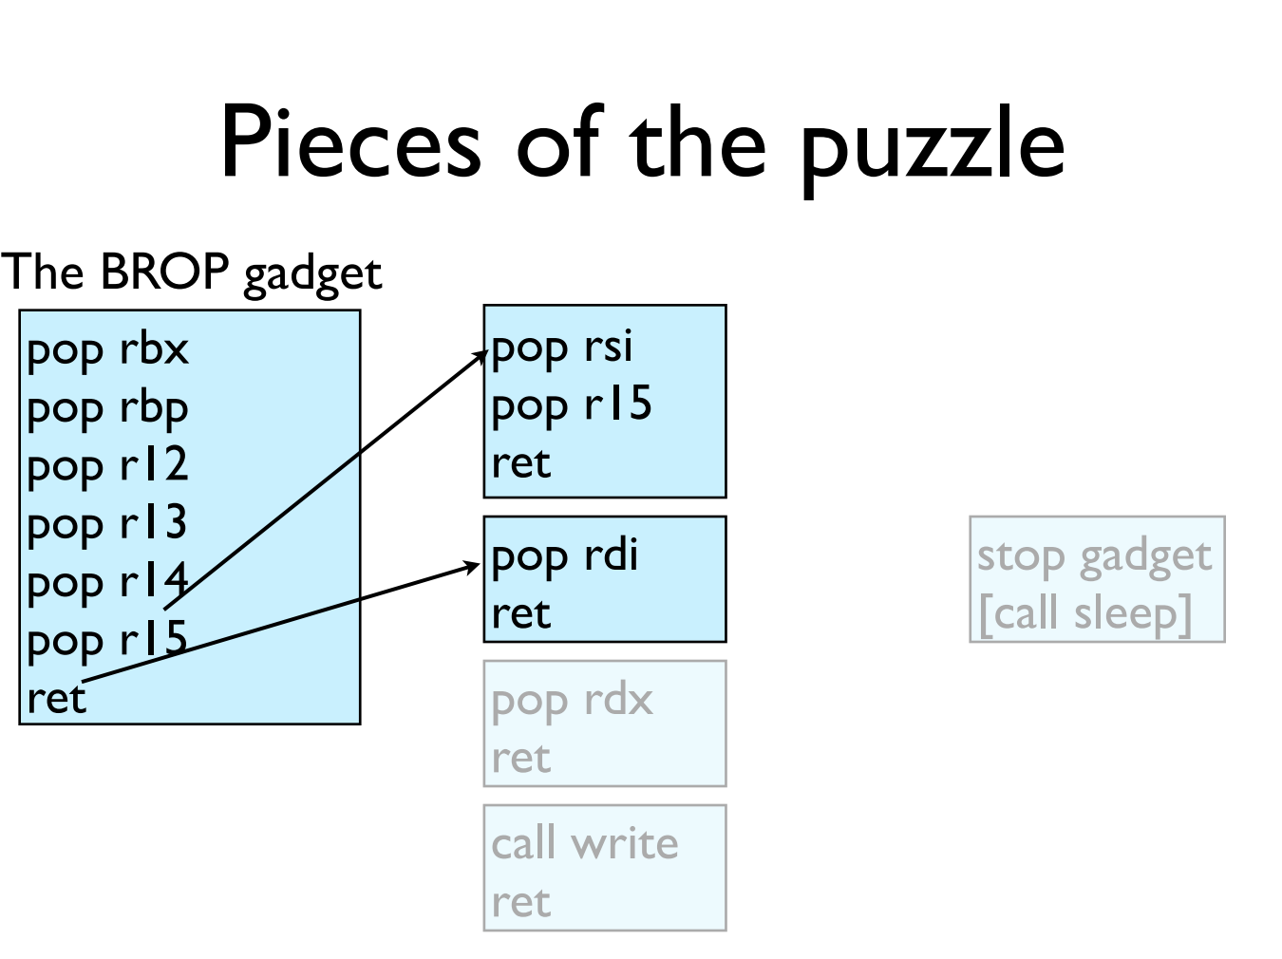

Slide 64
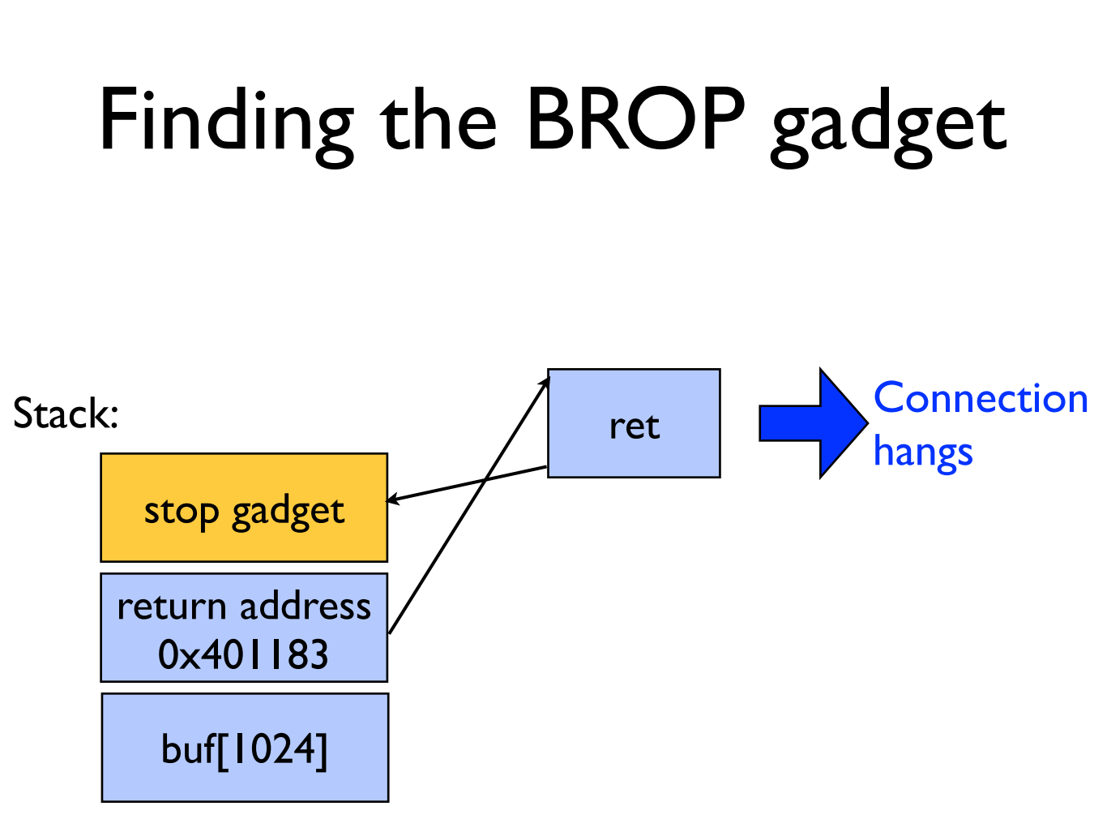

Slide 65
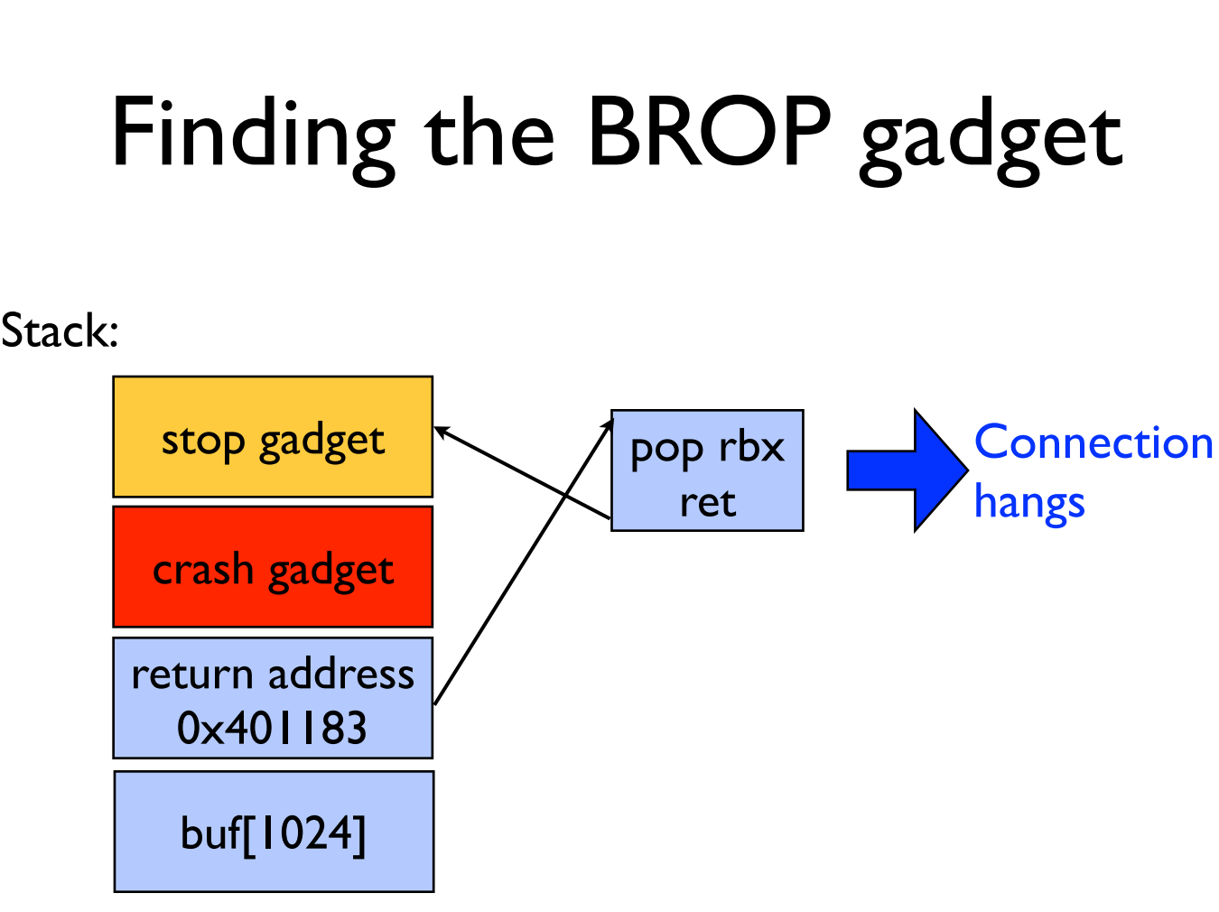

Slide 66
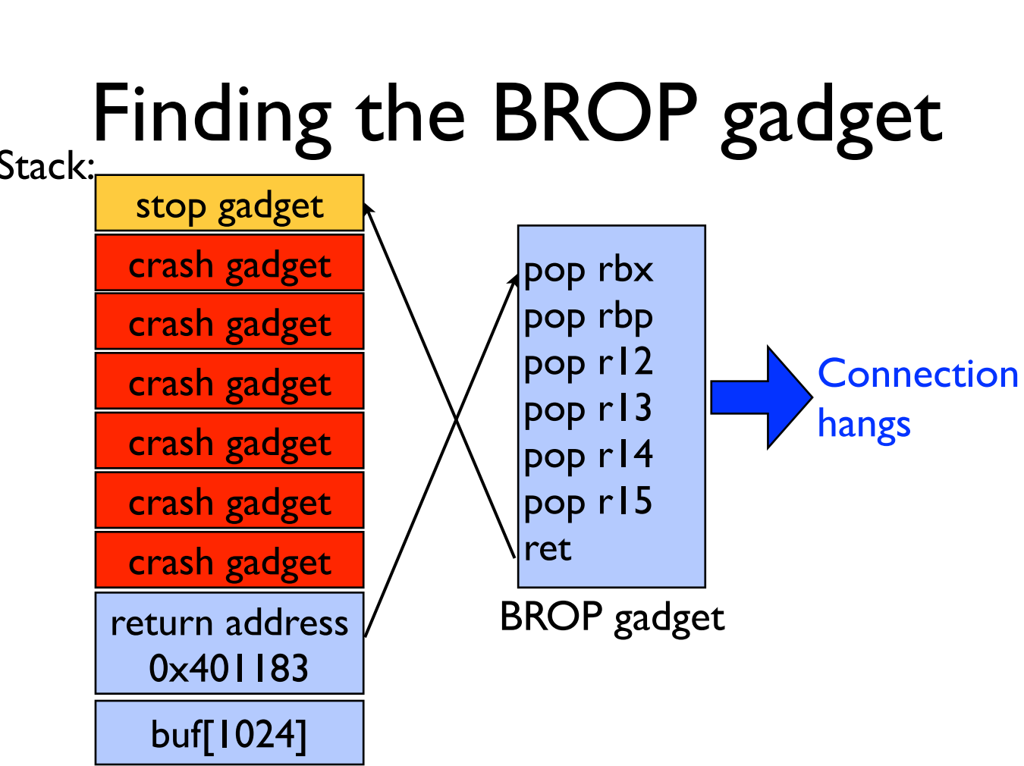

Slide 67
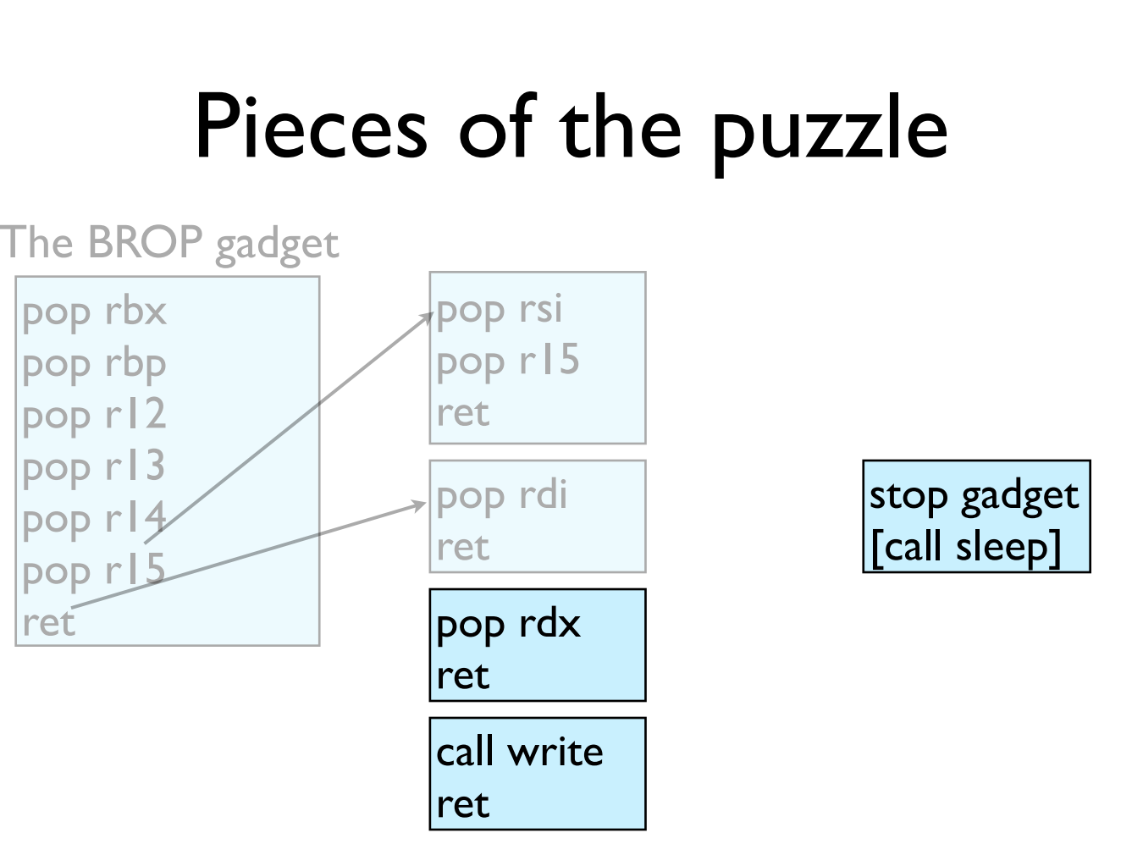

Slide 68
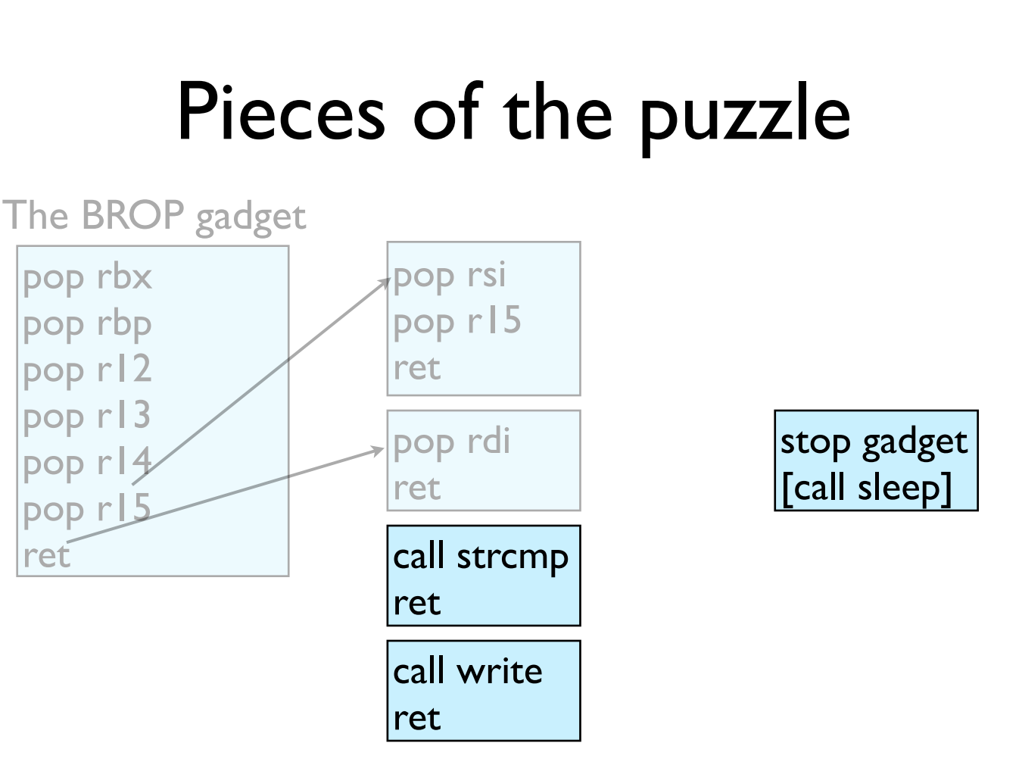

Slide 69
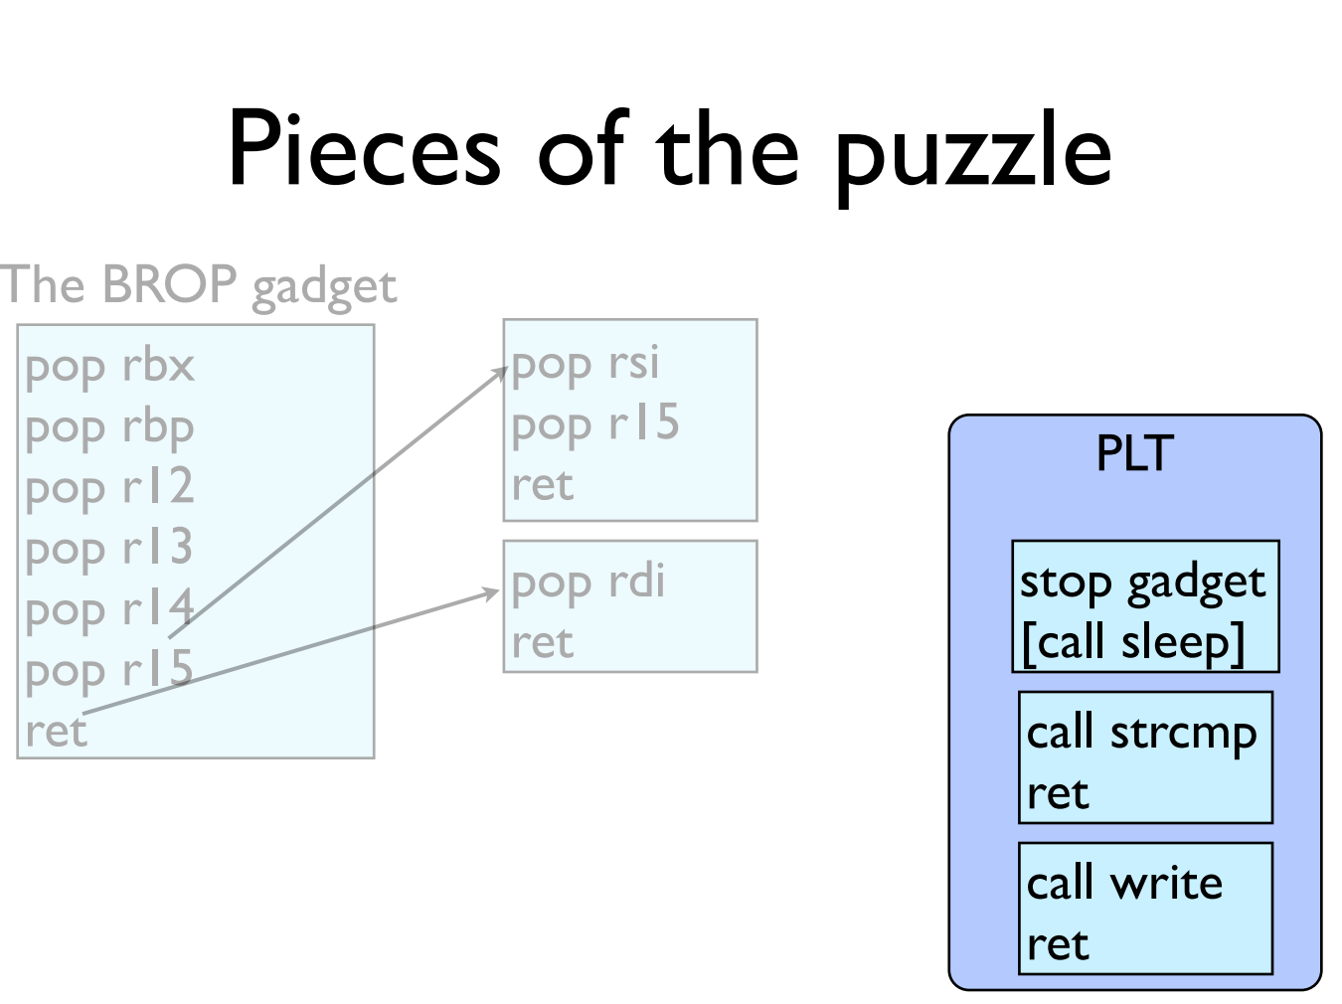

Slide 70
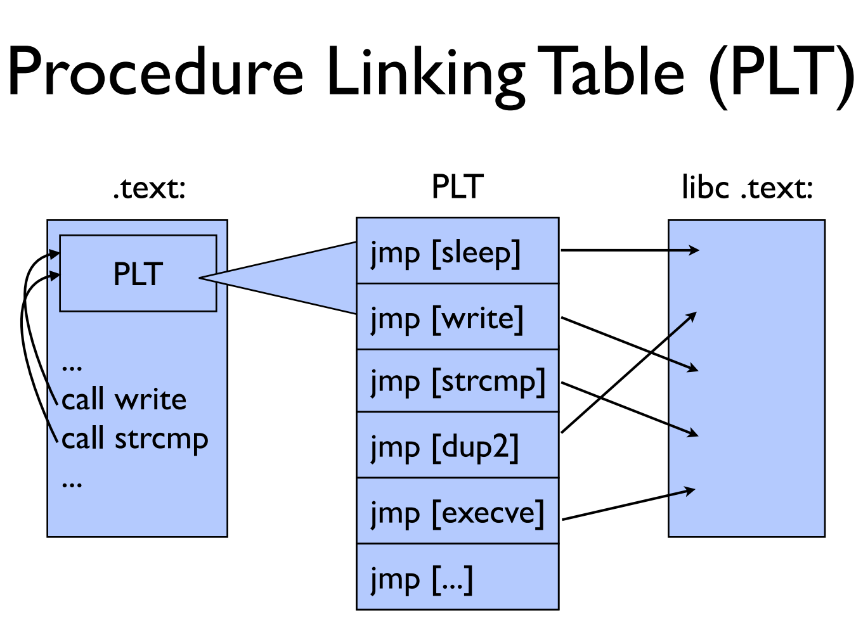

Slide 71
GOT & PLT
Jump to the address that this entry of the GOT contains:
First time: call to dynamic linker and write the function address to GOT
Not first time: the GOT already contains the address that points to printf.
PLT
printf() call
Dynamic linker
libc
GOT

Slide 72
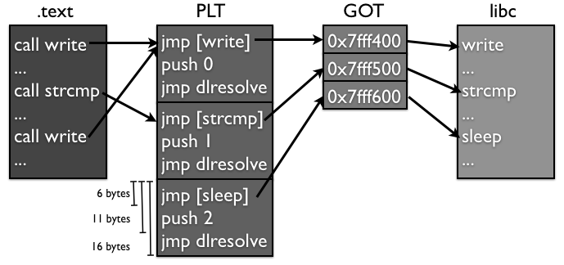
Notes:
另外，大部分的PLT项都不会因为传进来的参数的原因crash，因为它们很多都是系统调用，都会对参数进行检查，如果有错误会返回EFAULT而已，并不会造成进程crash。所以攻击者可以通过下面这个方法找到PLT：如果攻击者发现好多条连续的16个字节对齐的地址都不会造成进程crash，而且这些地址加6得到的地址也不会造成进程crash，那么很有可能这就是某个PLT对应的项了。

Slide 73
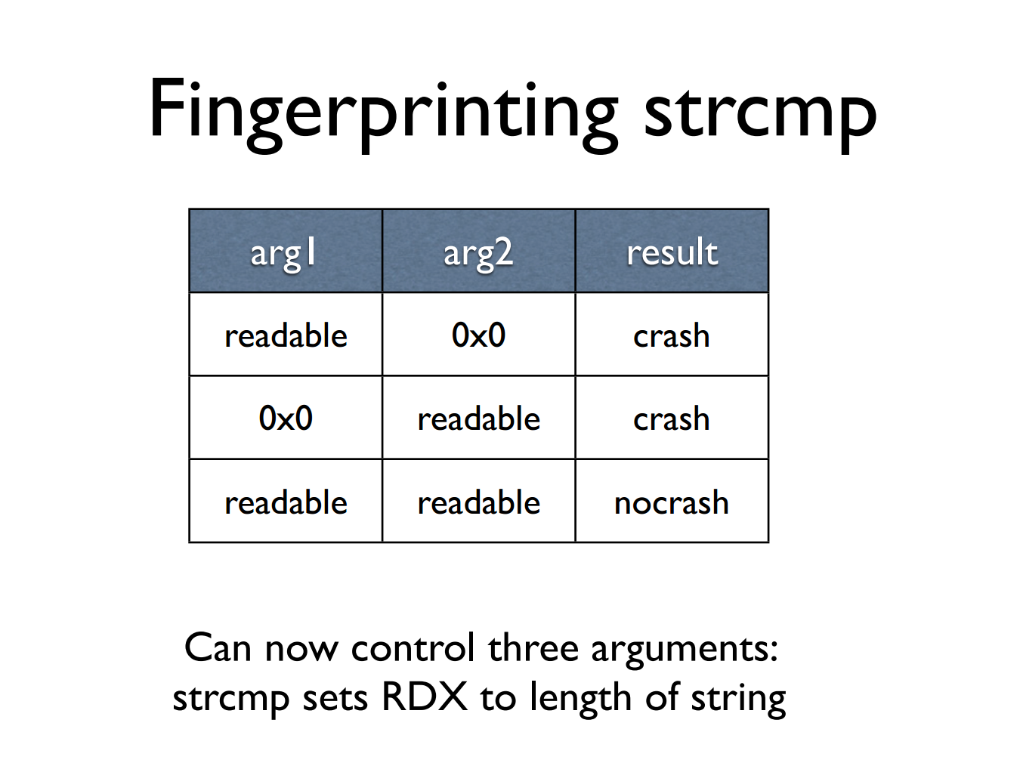

Slide 74
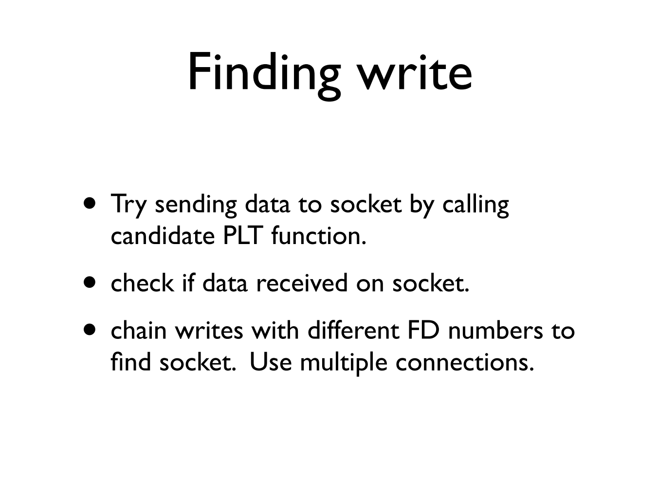
Notes:
1. 同时调用好几次write，把它们串起来，然后传入不同的文件描述符数；2. 同时打开多个连接，然后使用一个相对较大的文件描述符数字，增加匹配的可能性。

Slide 75
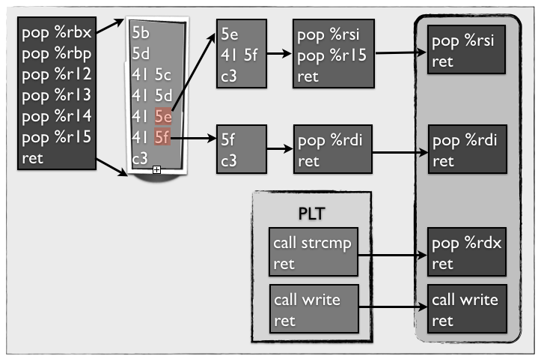

Slide 76
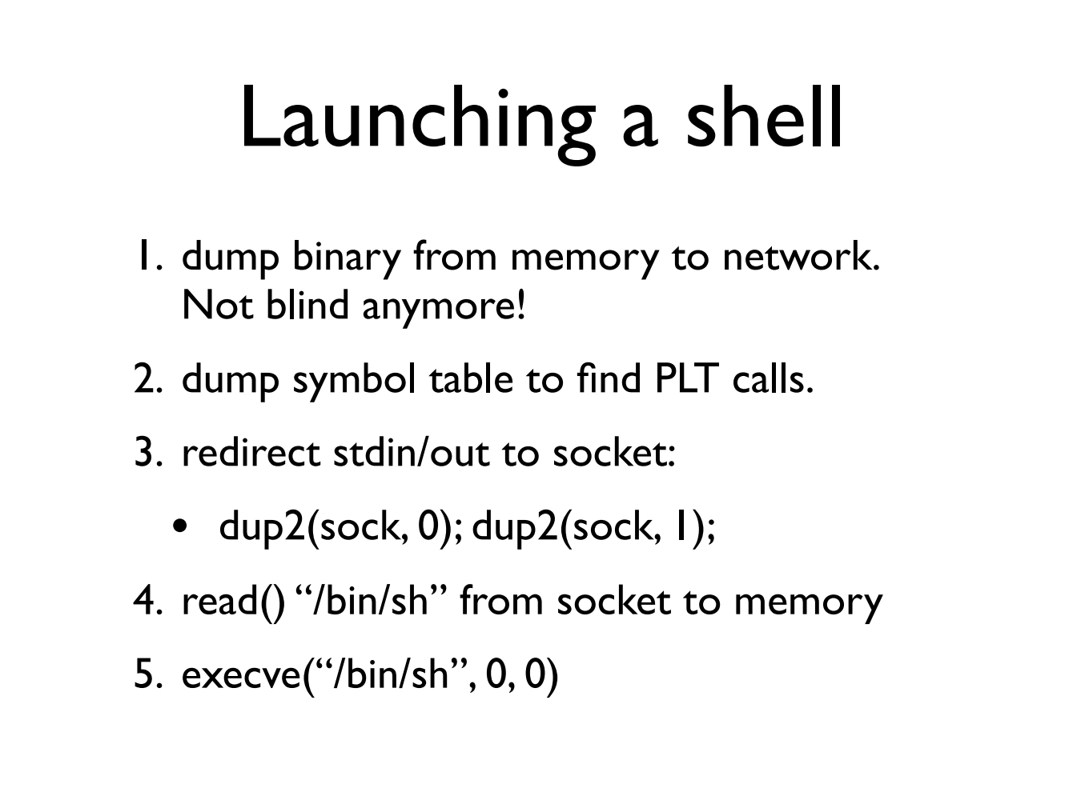

Slide 77


Slide 78


Slide 79
Try It!
http://www.scs.stanford.edu/brop/
More information
S&P'14 paper: http://www.scs.stanford.edu/brop/bittau-brop.pdf
Blog: http://drops.wooyun.org/tips/3071

